Slide 1
5 Litre Rack
April 2016

Slide 2
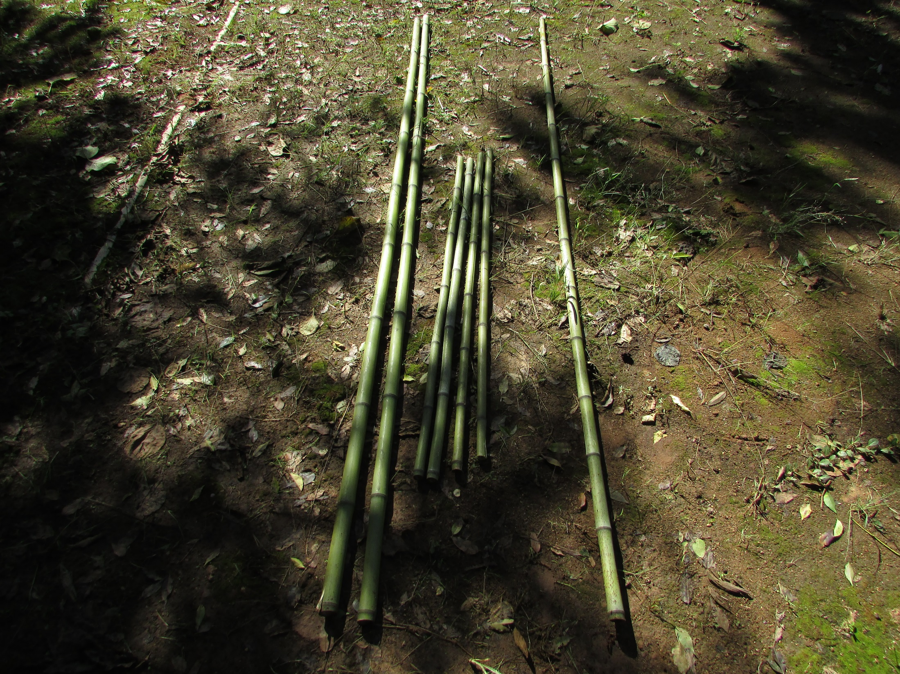
A third pole if you
want the rack to
be free standing
2 x strong poles
of about 40mm D
and 2500mm length
There is no need for the third pole if the rack is leaning against a wall
4 x 1200mm cross beams of about 25mm D

Slide 3
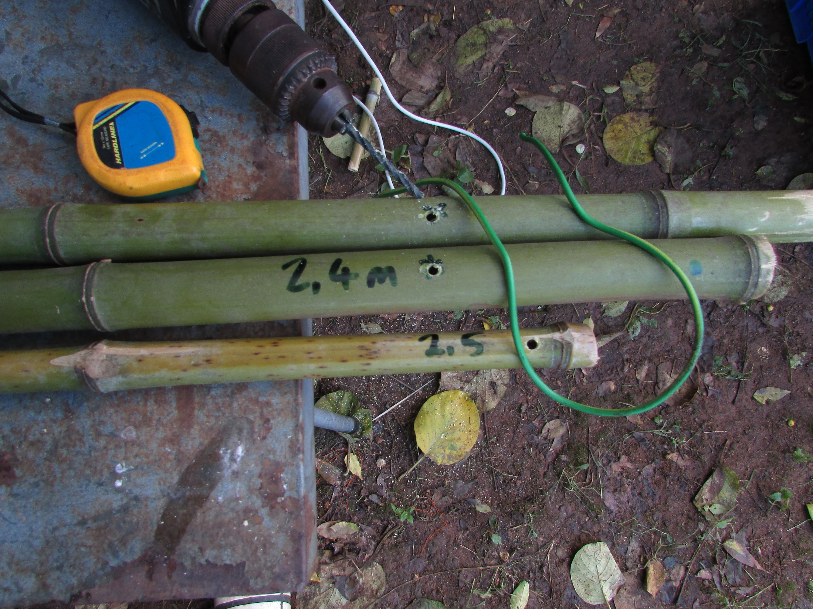
Drill 4mm holes at 2400mm
on the two uprights and at
2500 on the support beam.
300mm of strong
single-core cable

Slide 4
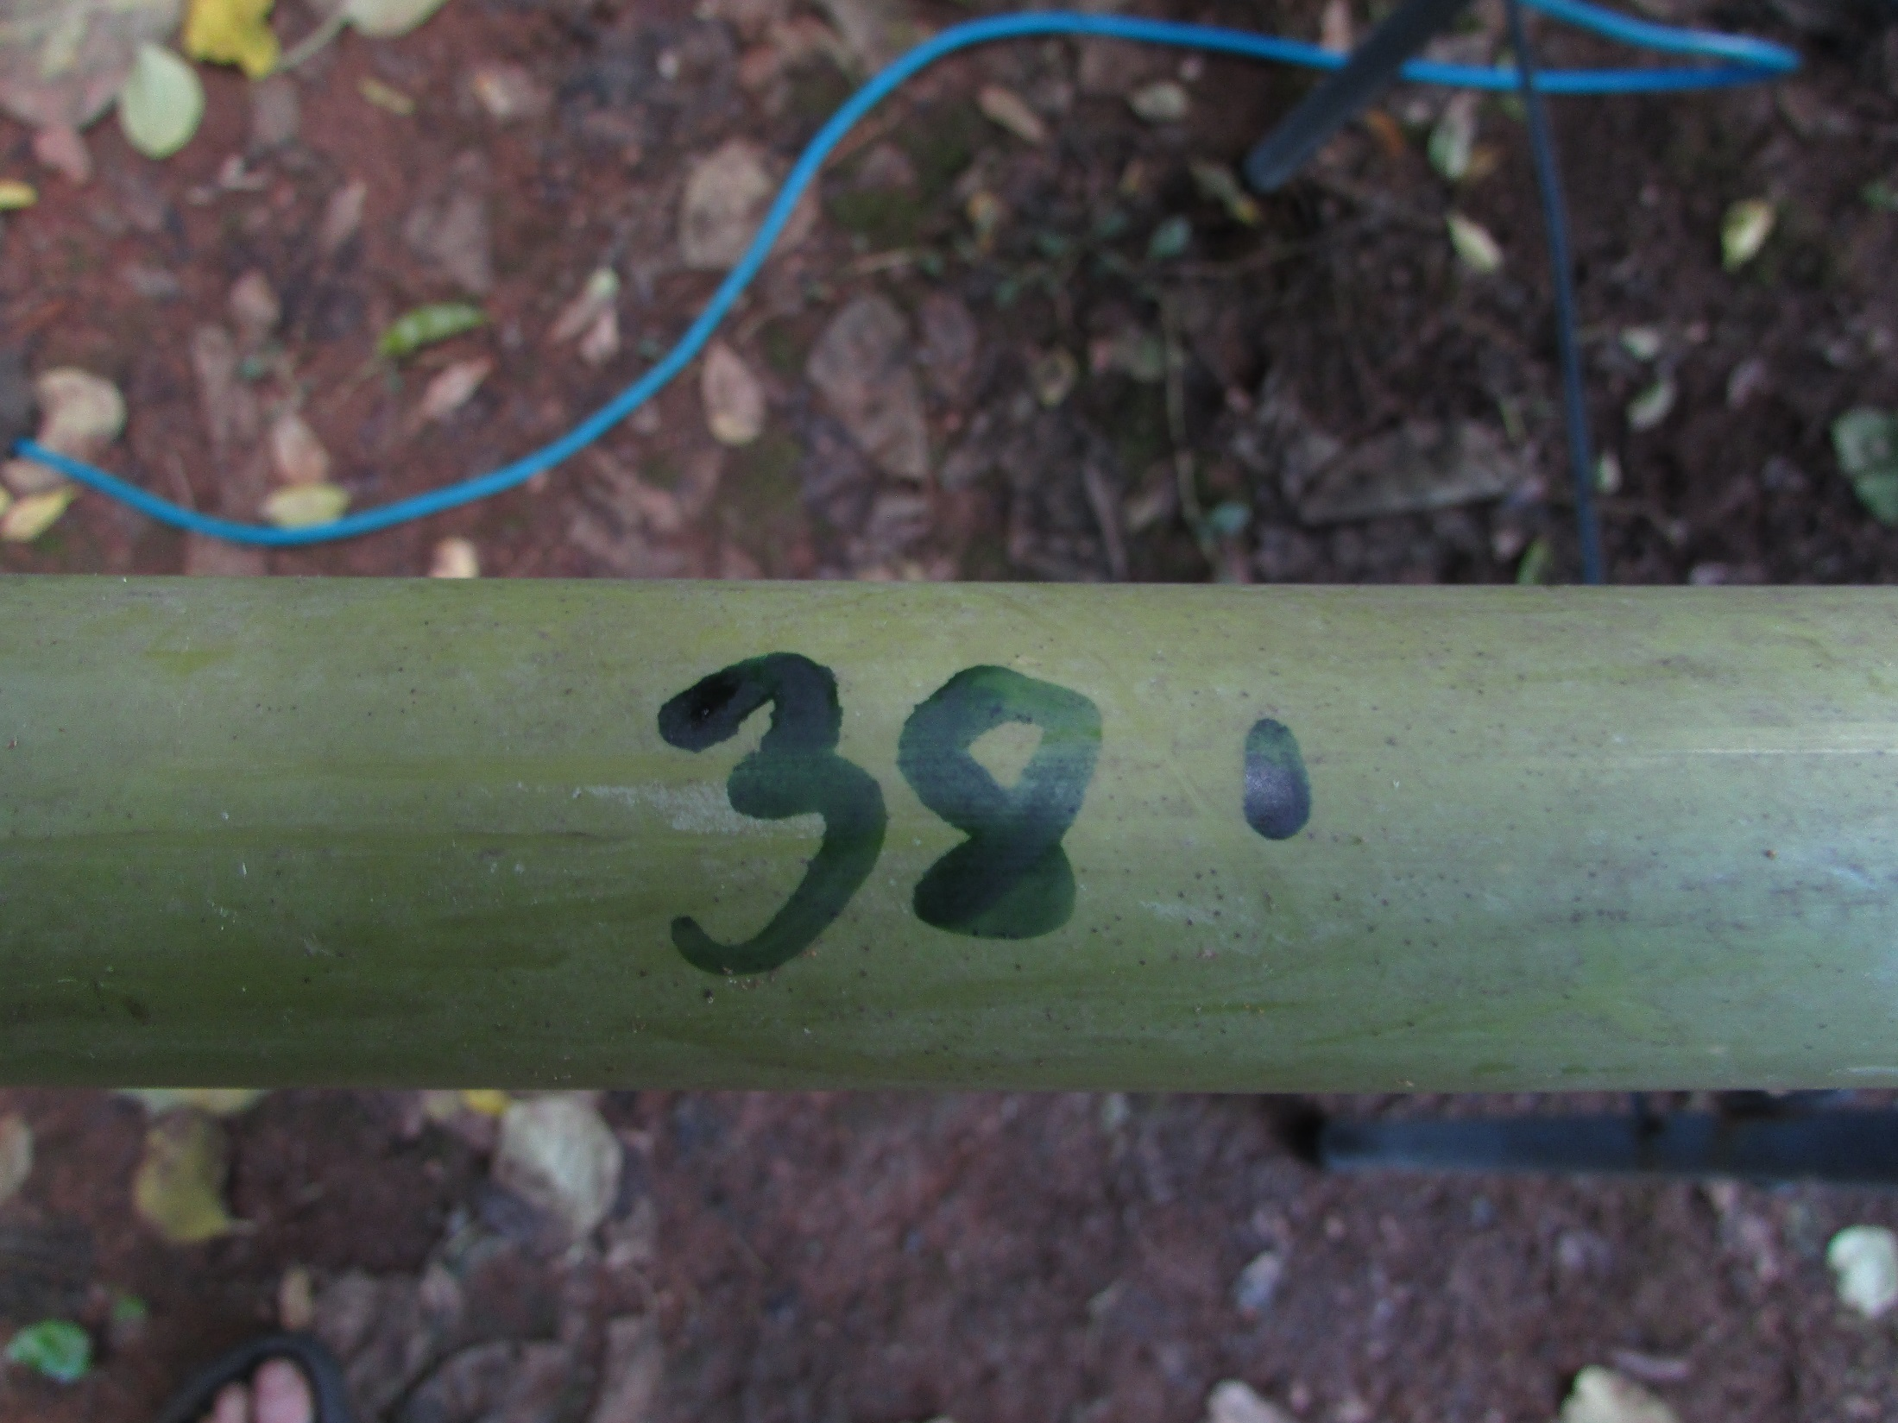
Put marks on the uprights
at 380mm from the bottom

Slide 5
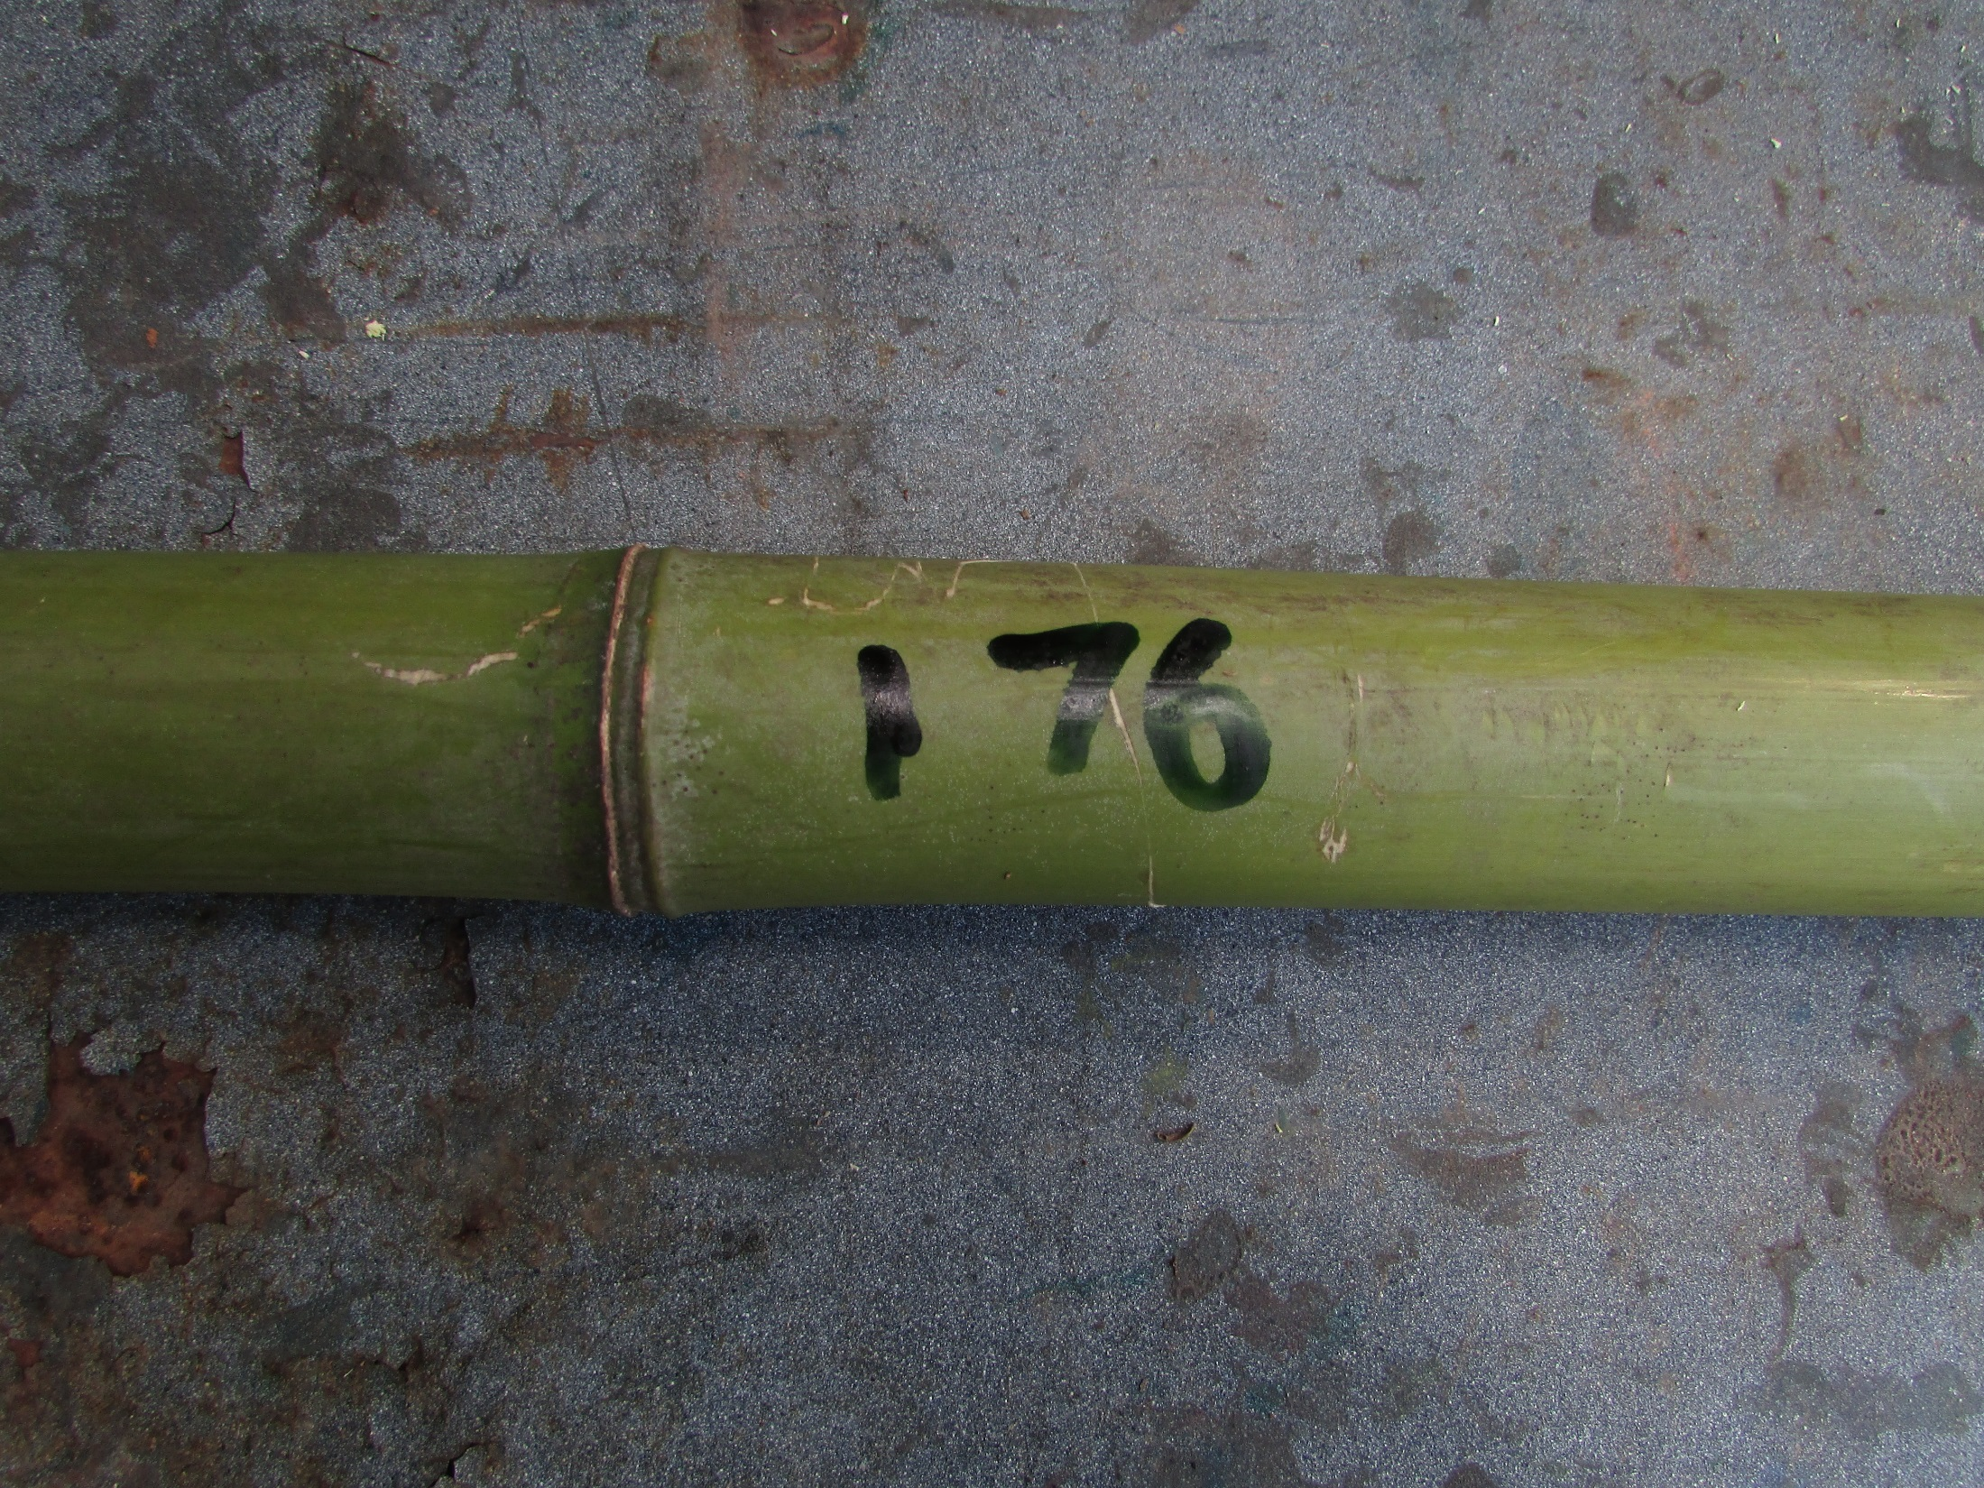
…and 760mm

Slide 6
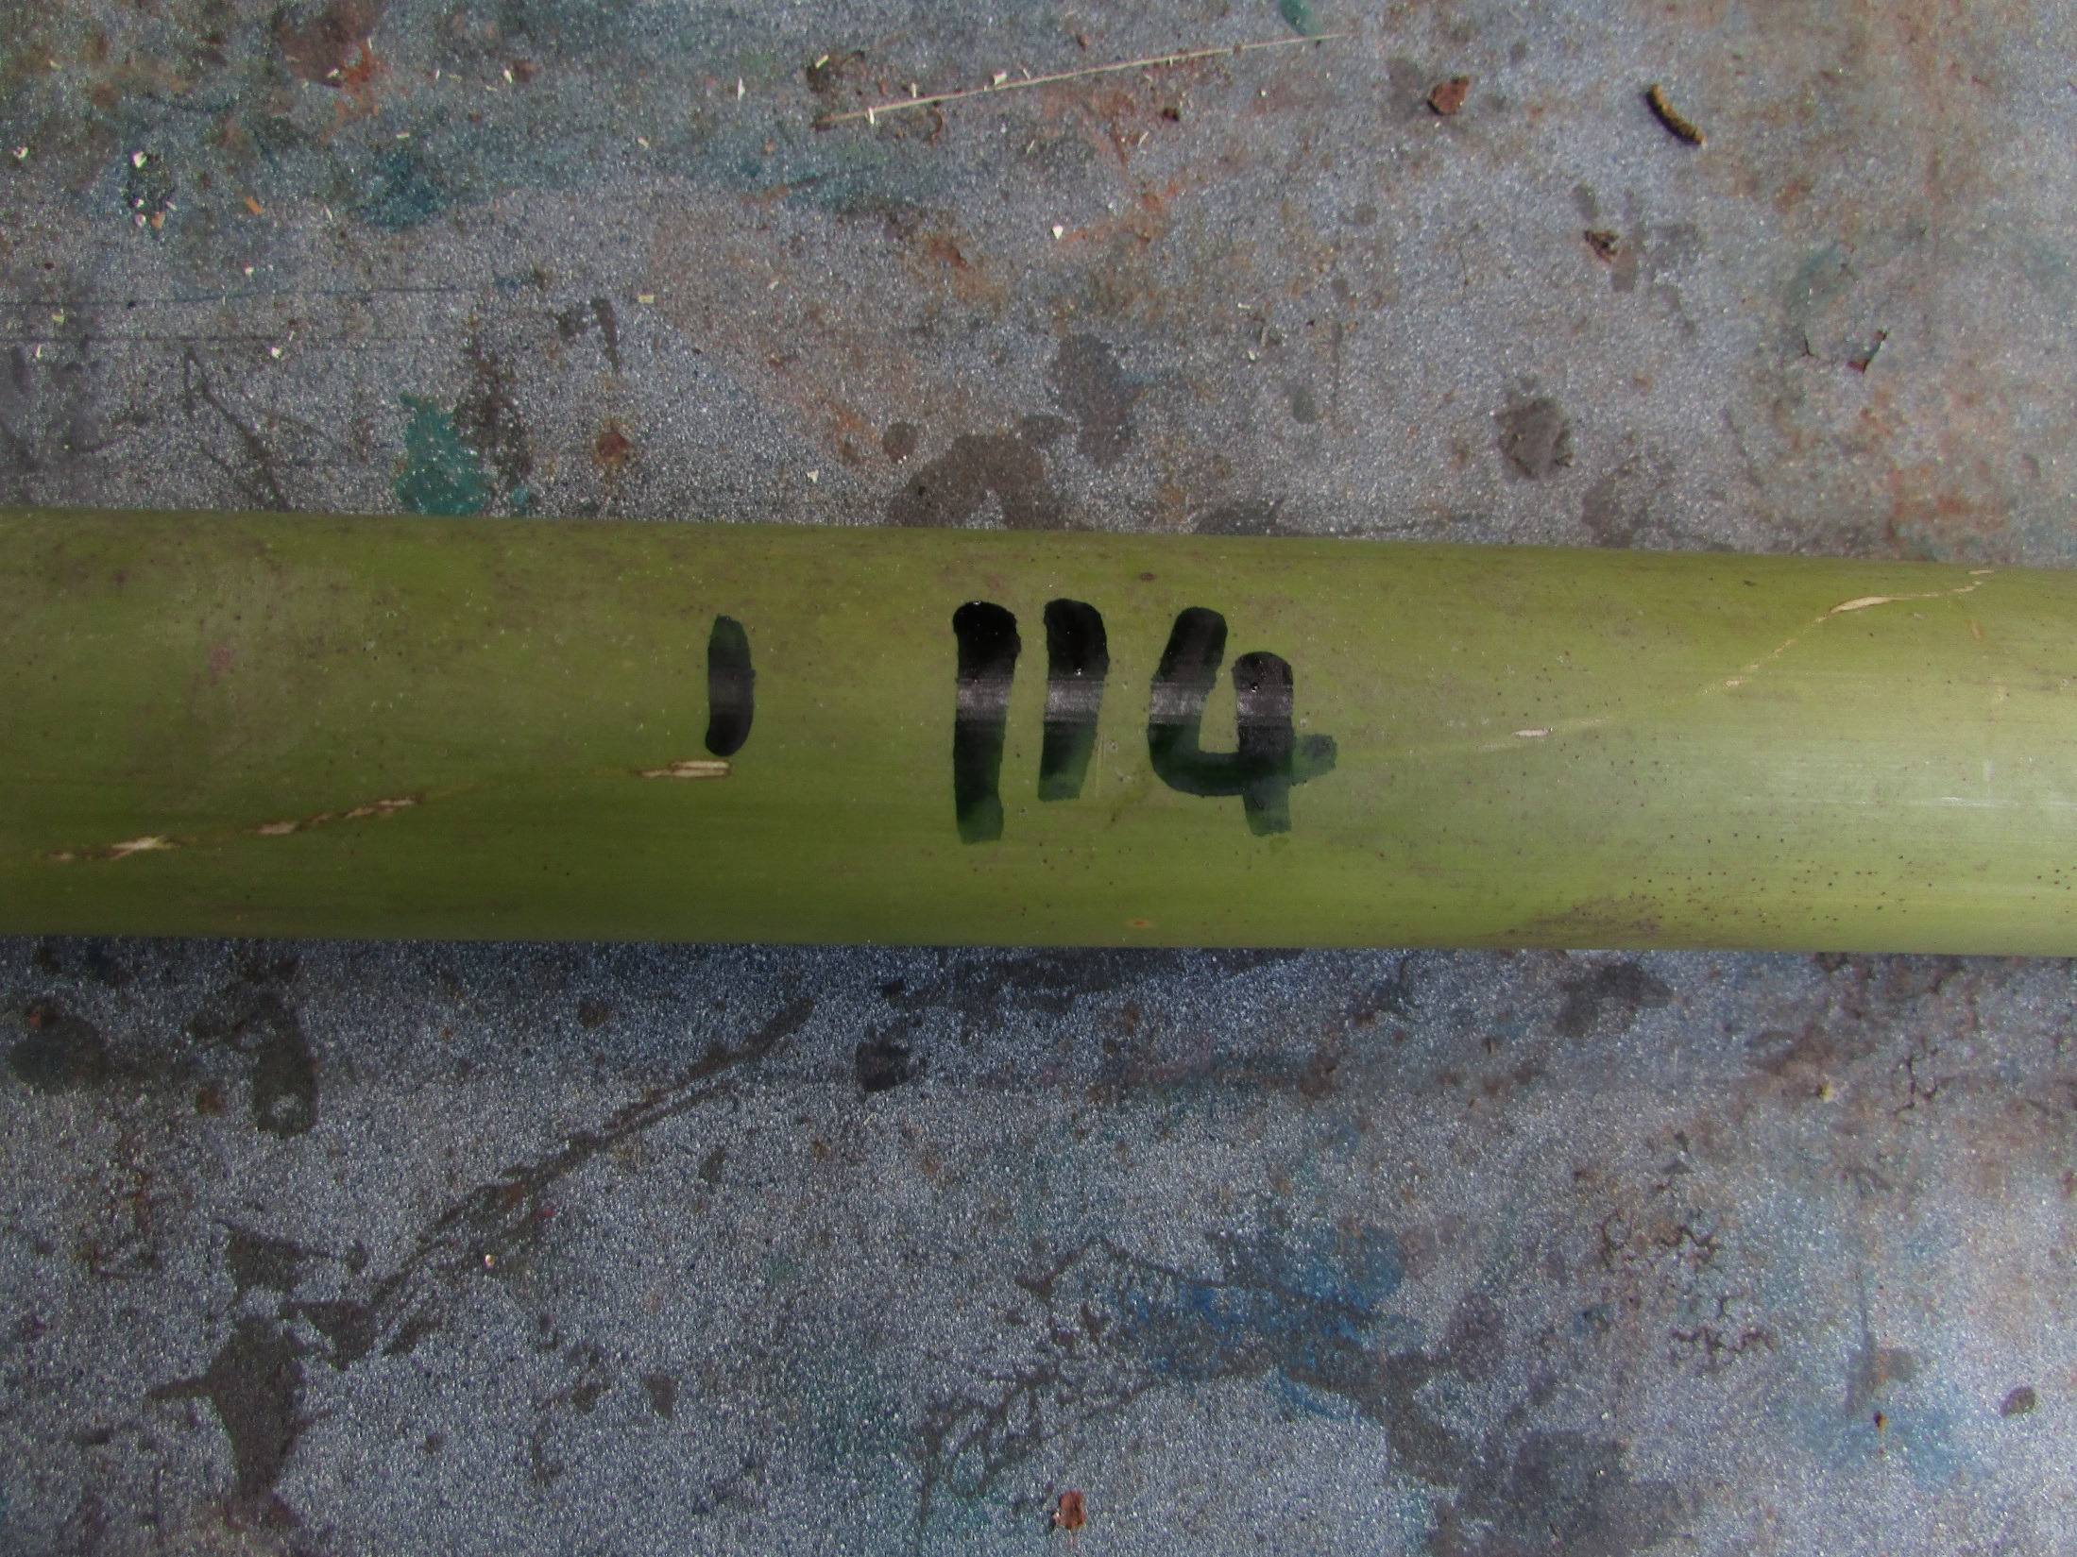
… and 1140

Slide 7
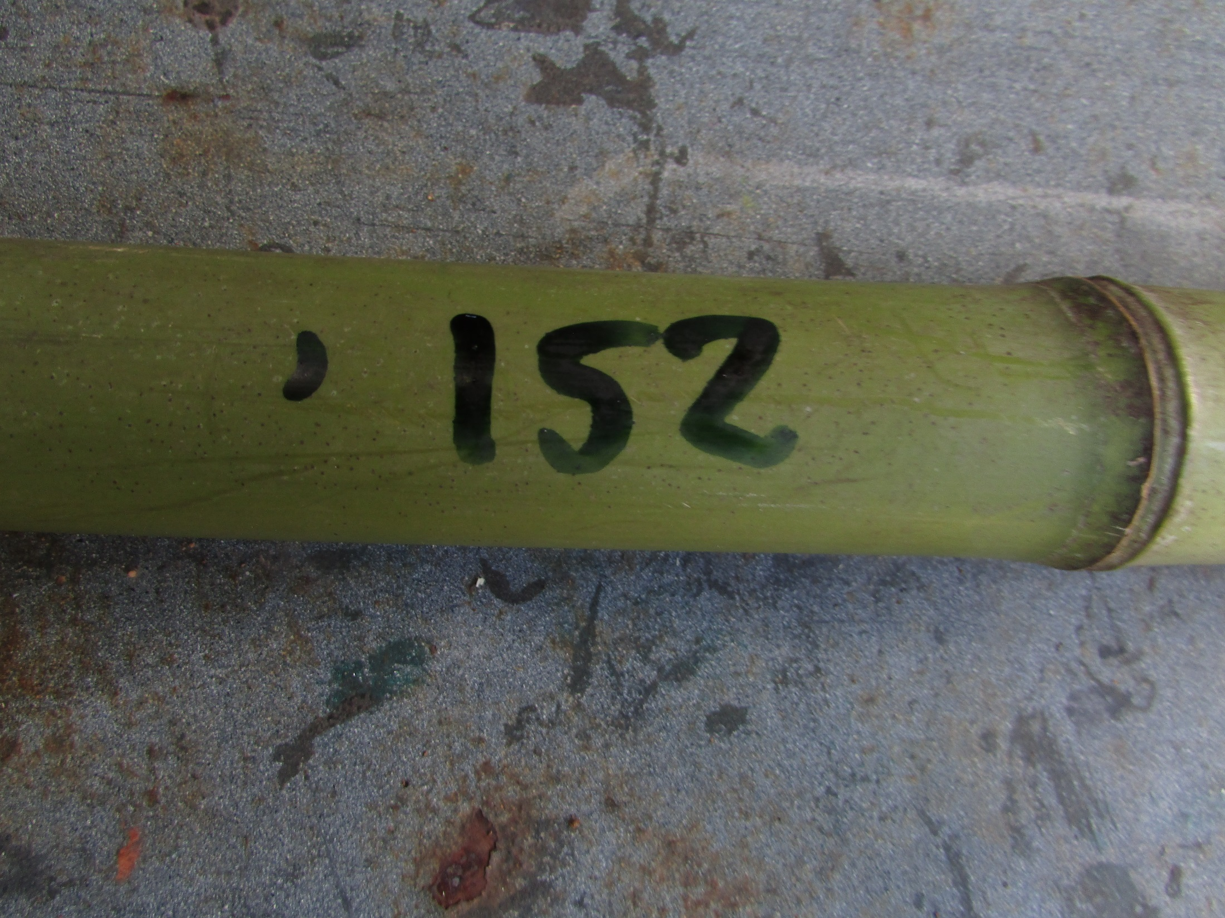
… and at 1520

Slide 8
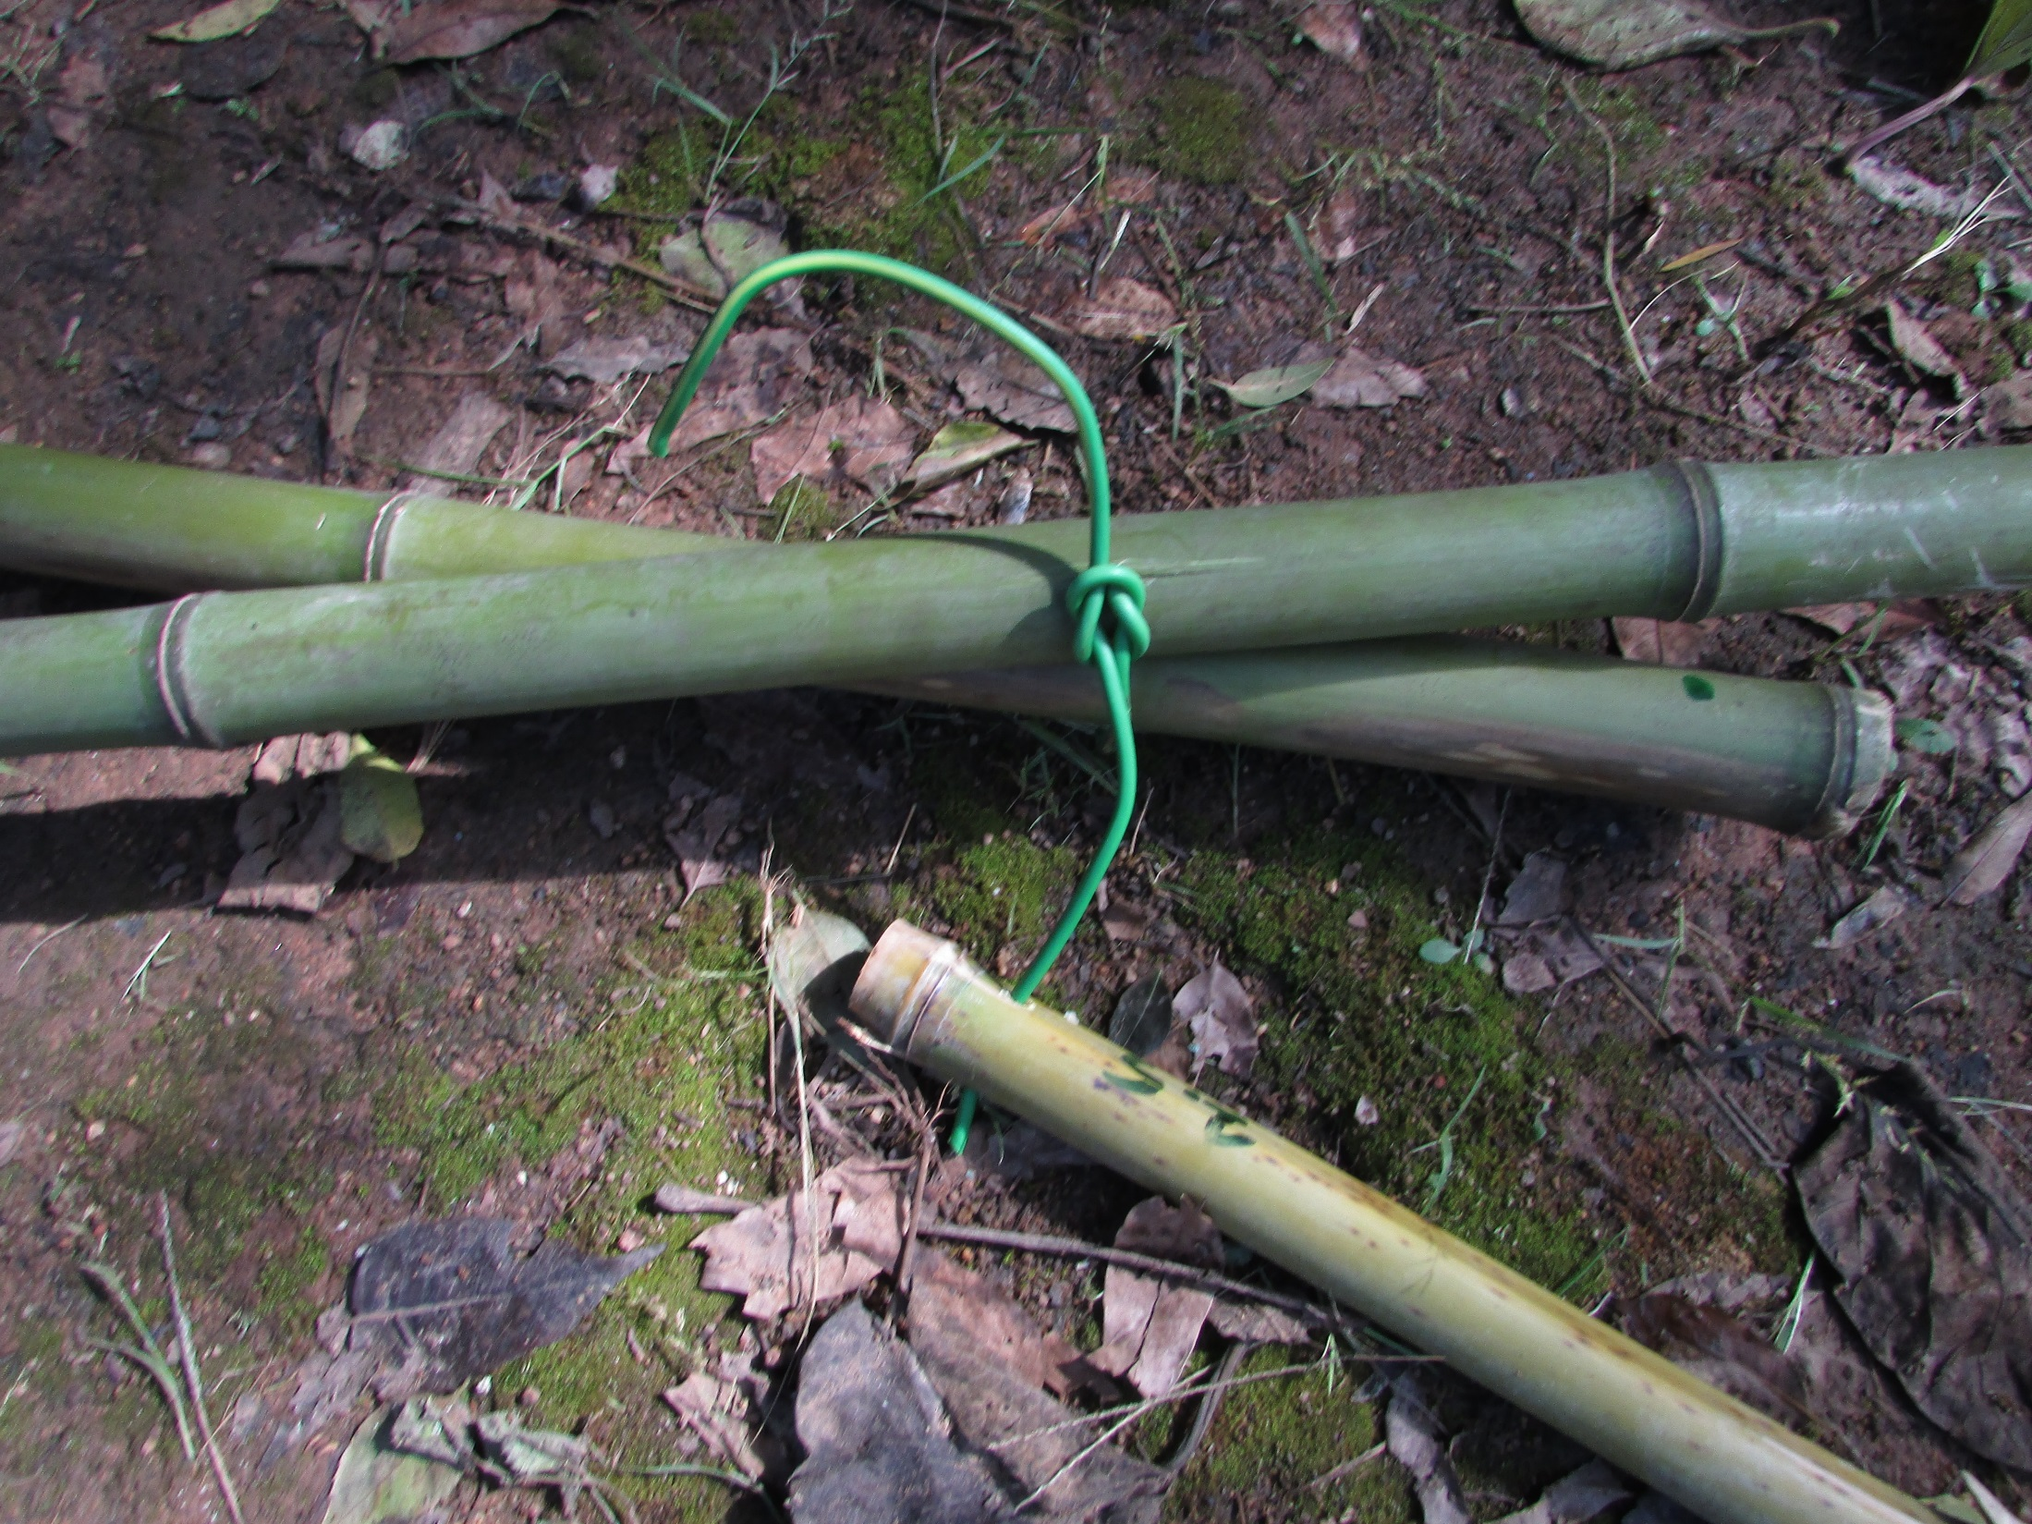
Tie the top ends of the
uprights together

Slide 9
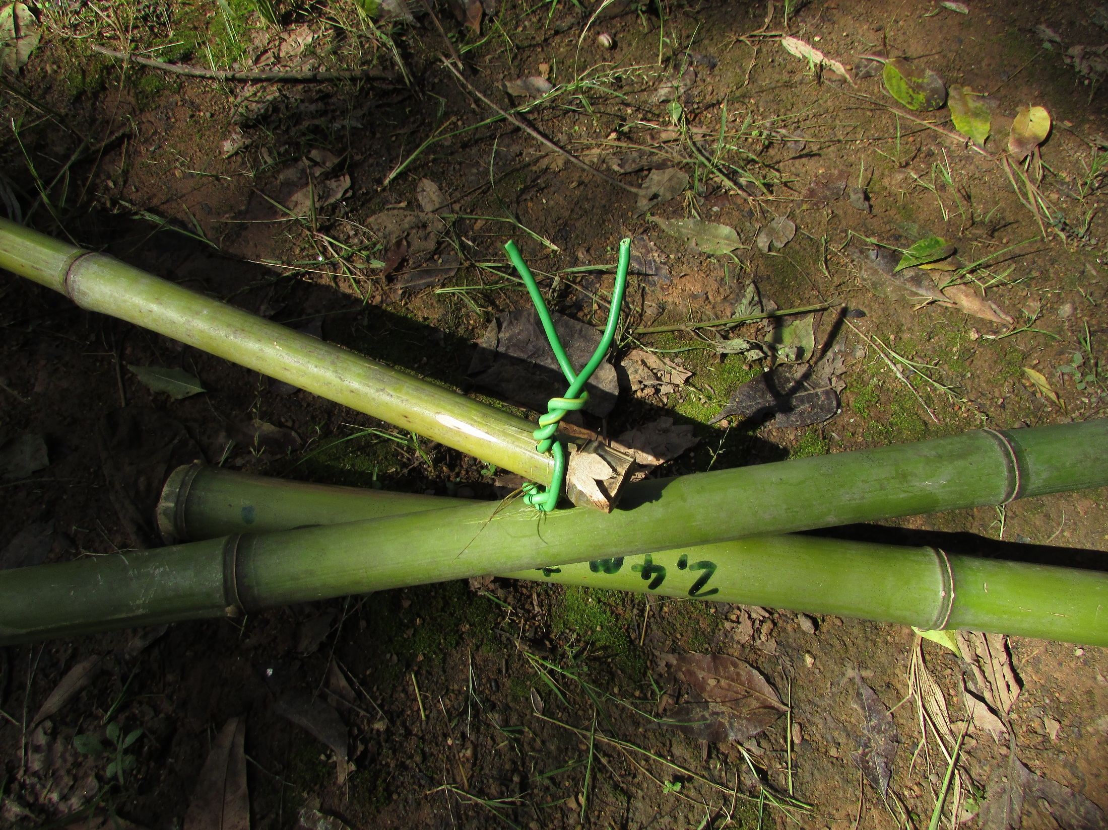
Then tie on the support pole

Slide 10
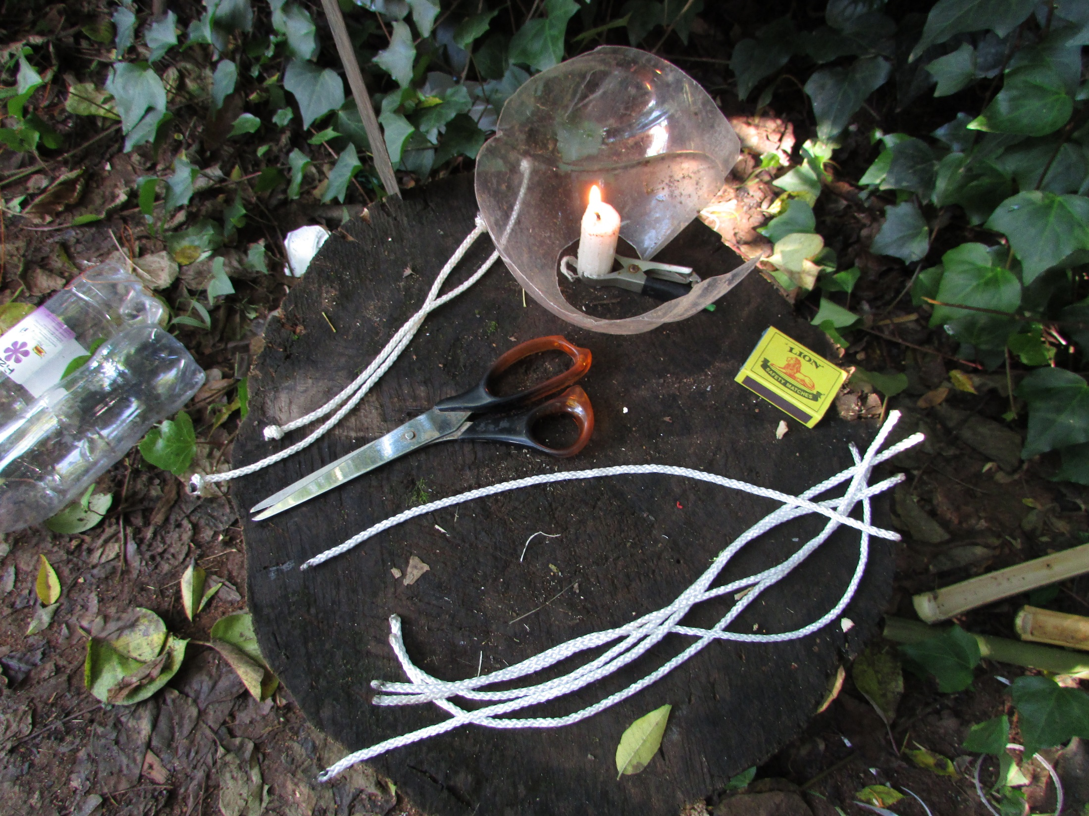
8 x 3mm strong cord
burnt and knotted at
both ends
340mm long

Slide 11
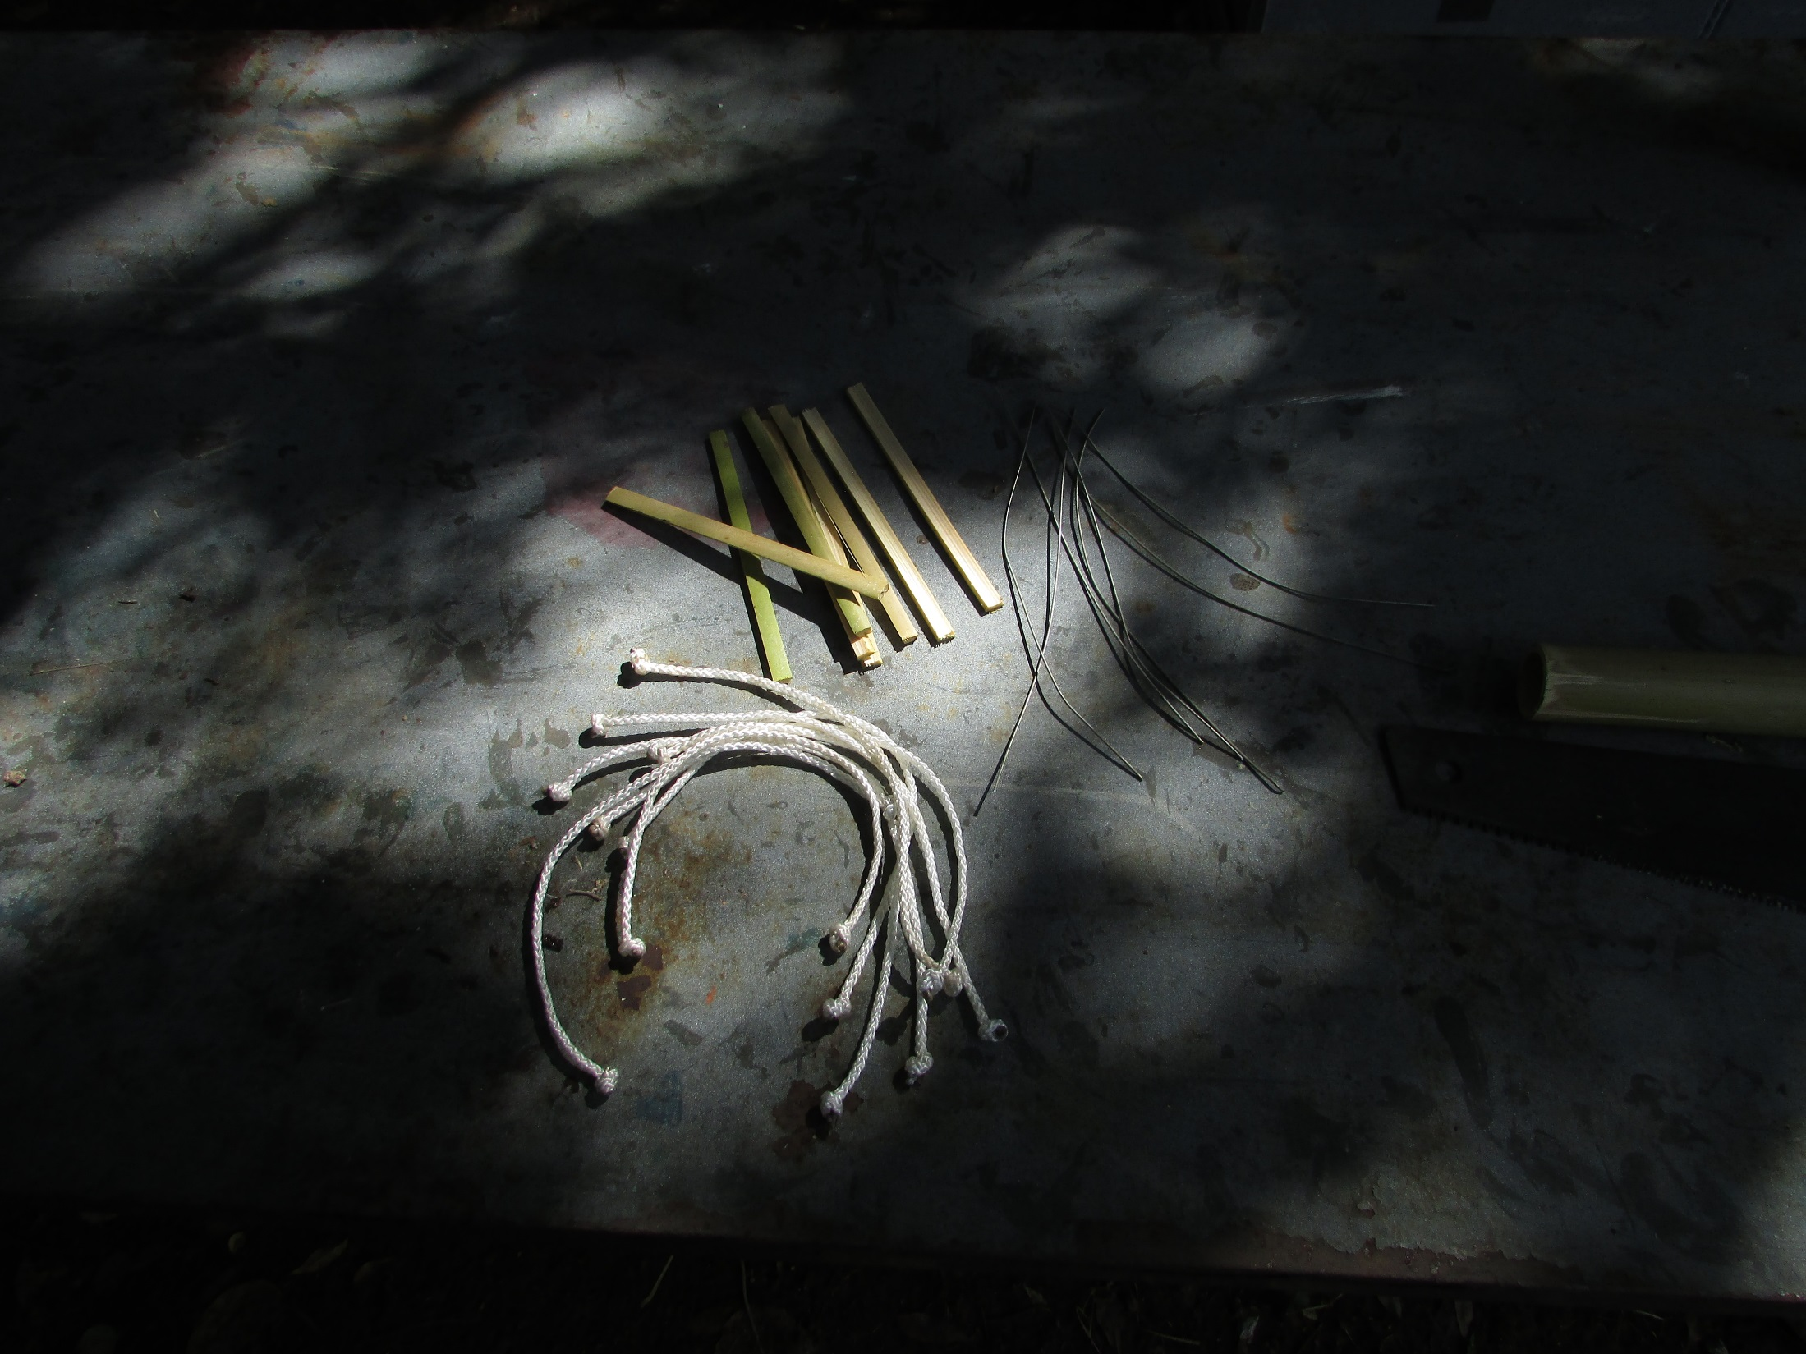
8 x retaining wires
(150mm)
8 x toggles

Slide 12
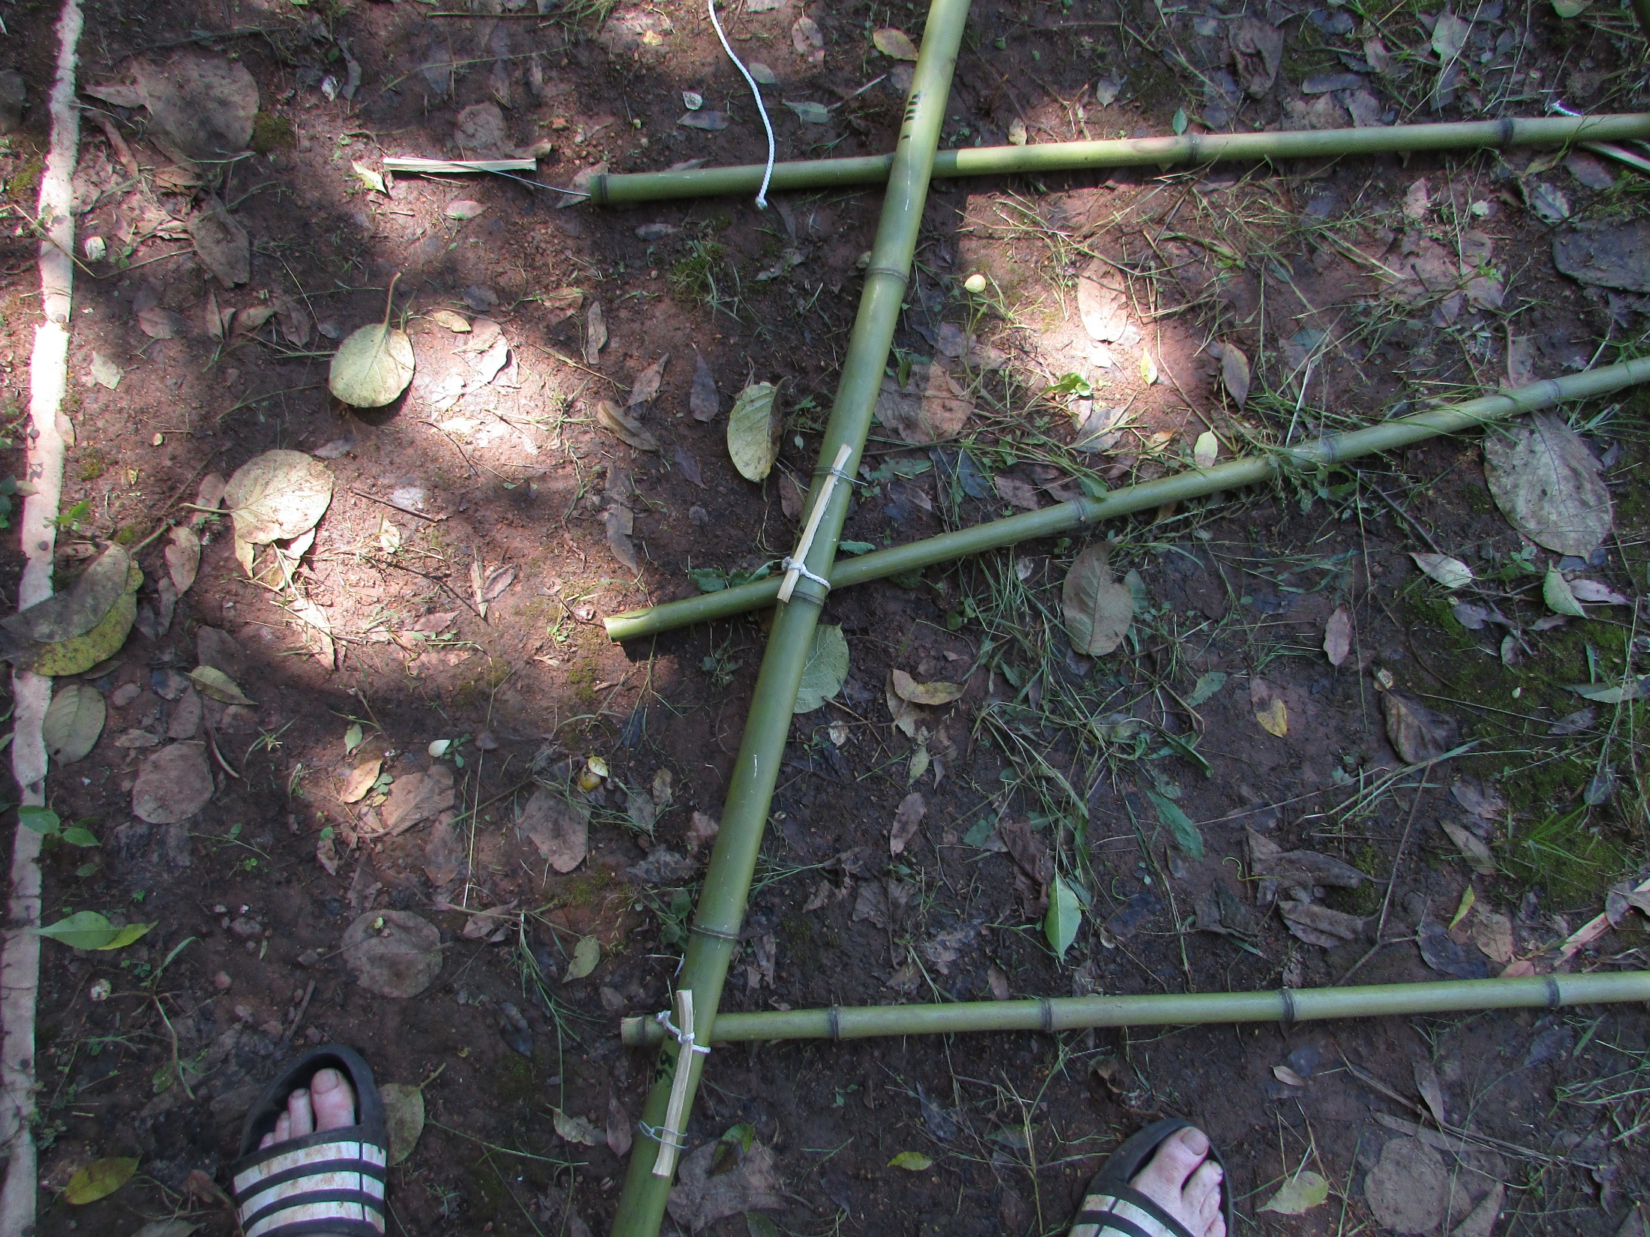

Slide 13
Set out the poles in an
“A” shape with the legs
of the “A” as wide as
possible. Place the cross
beams under the uprights

Slide 14
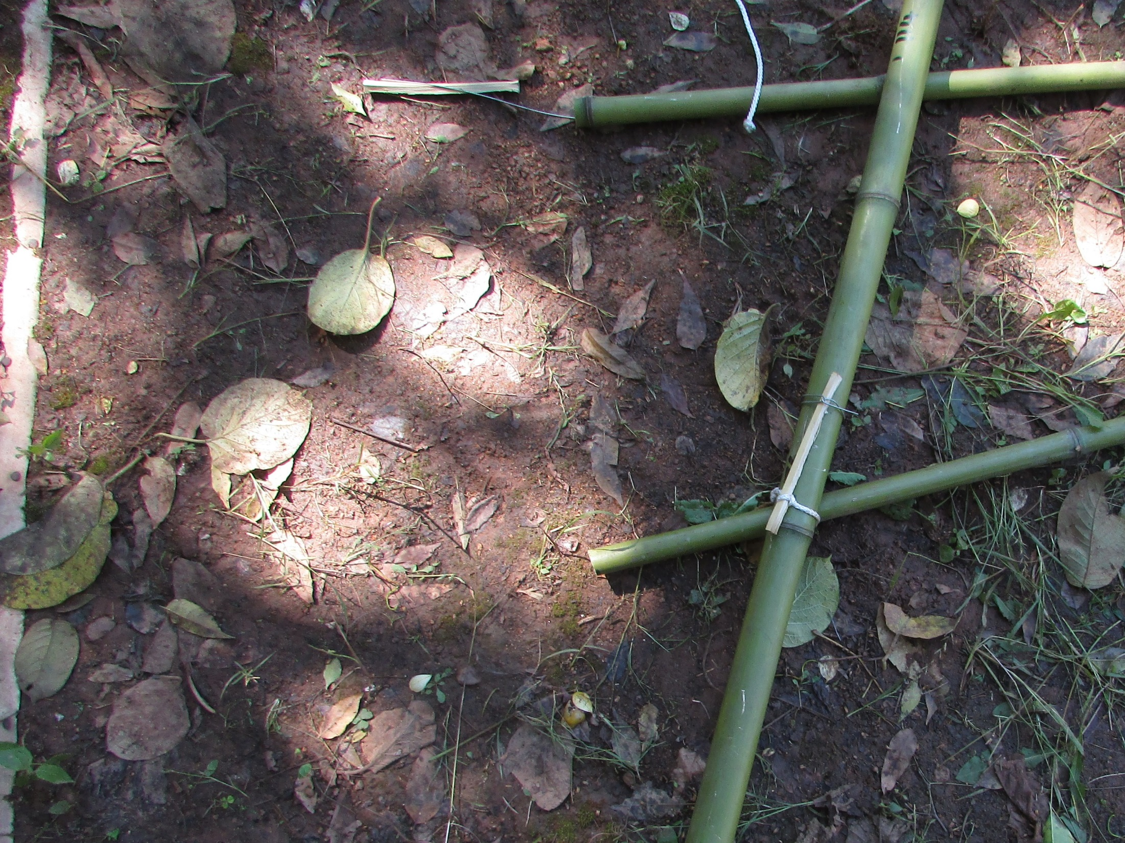
Tie the cord around the upright and the cross beam with a loose double reef knot.

Slide 15
Insert the toggle and twist. This will cause the cross beam to be lifted upwards a bit which is what you want. Secure the end of the toggle with the retaining wire.
Repeat for the right side bringing the cross beam back parallel.

Slide 16
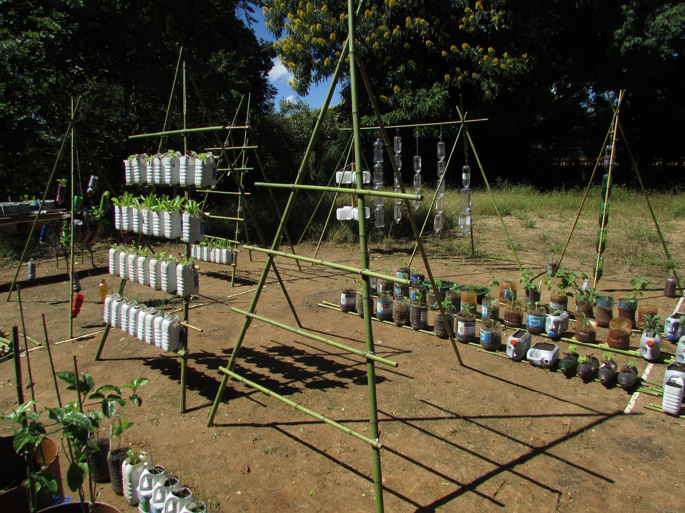

Slide 17
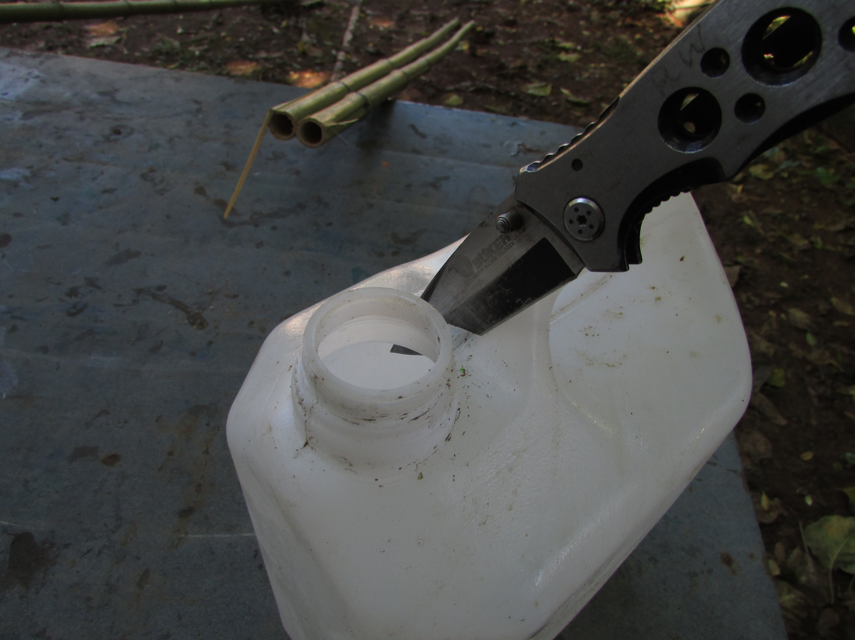

Slide 18
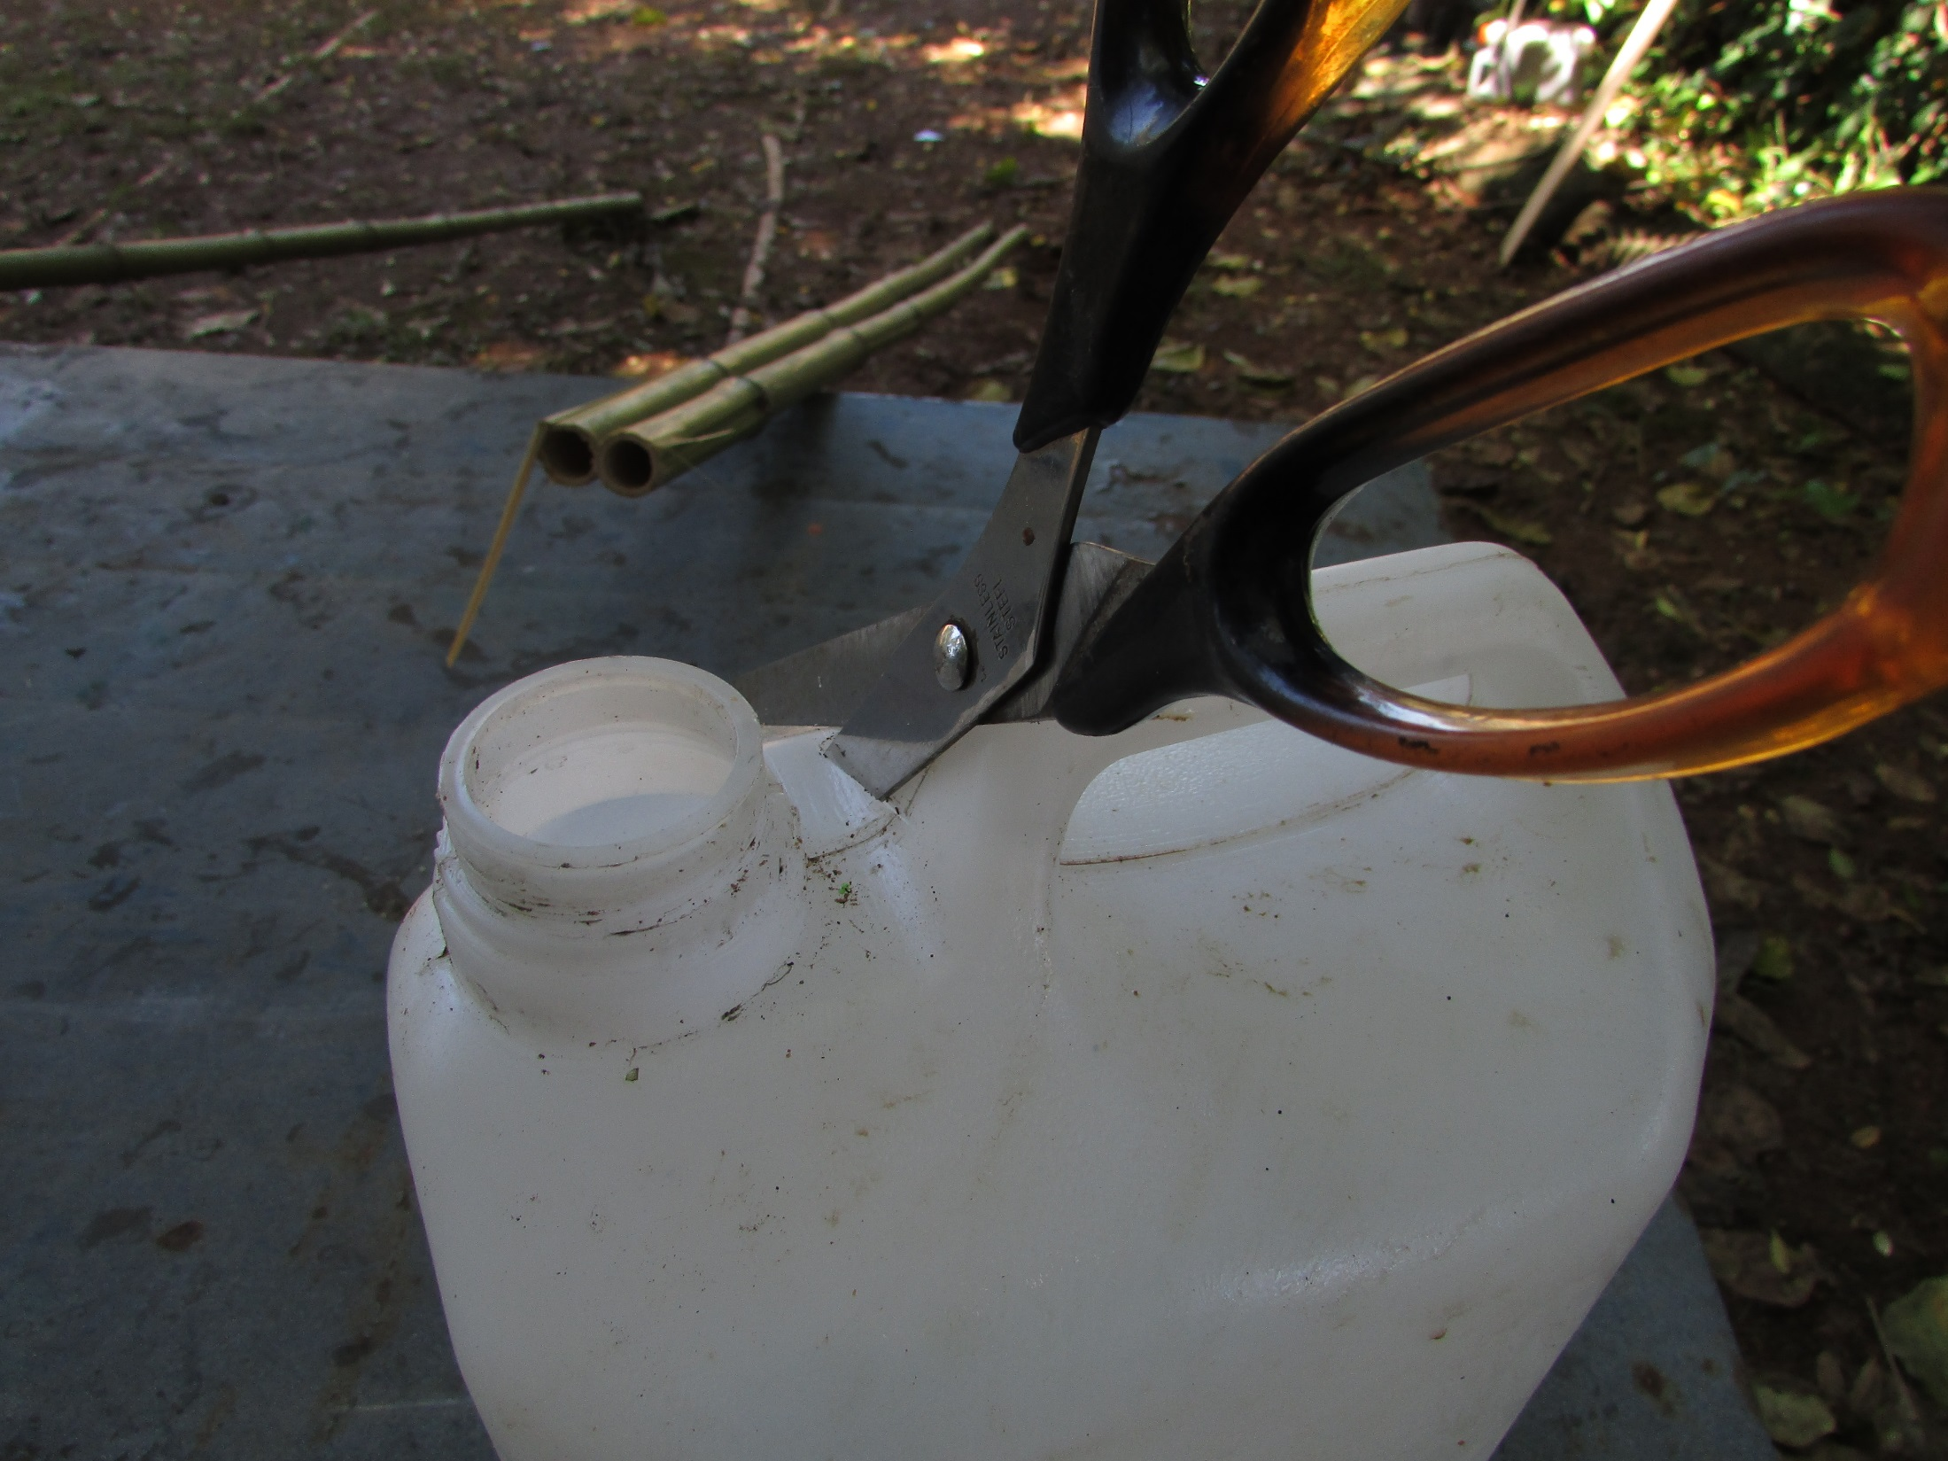

Slide 19
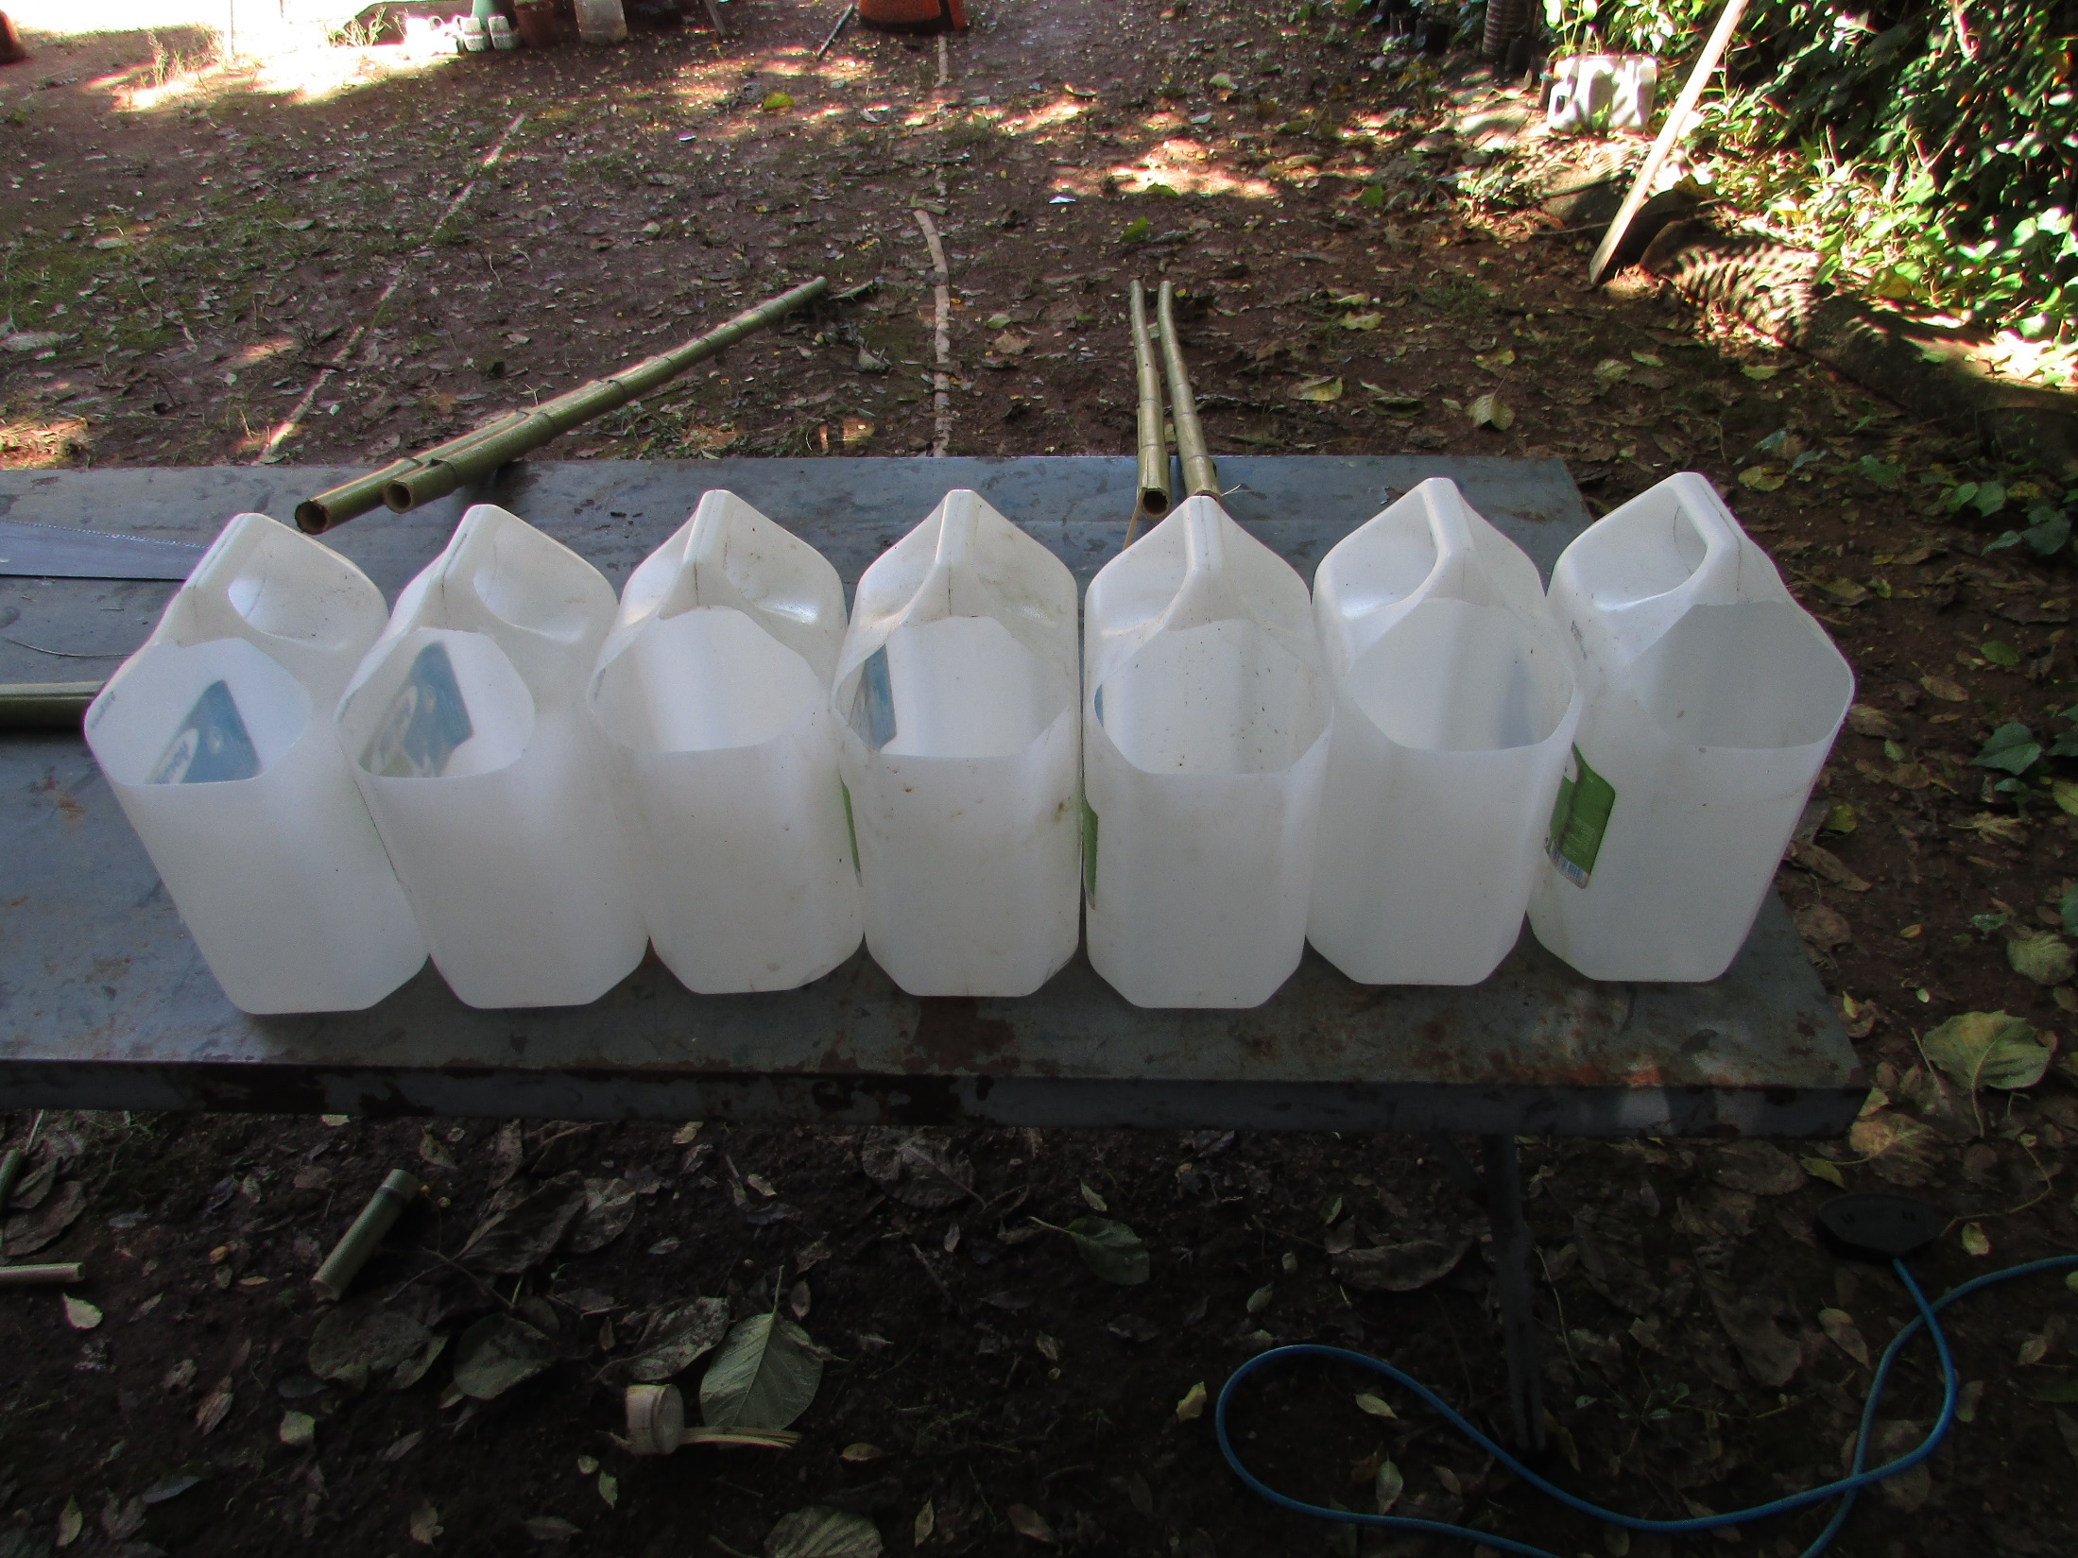

Slide 20
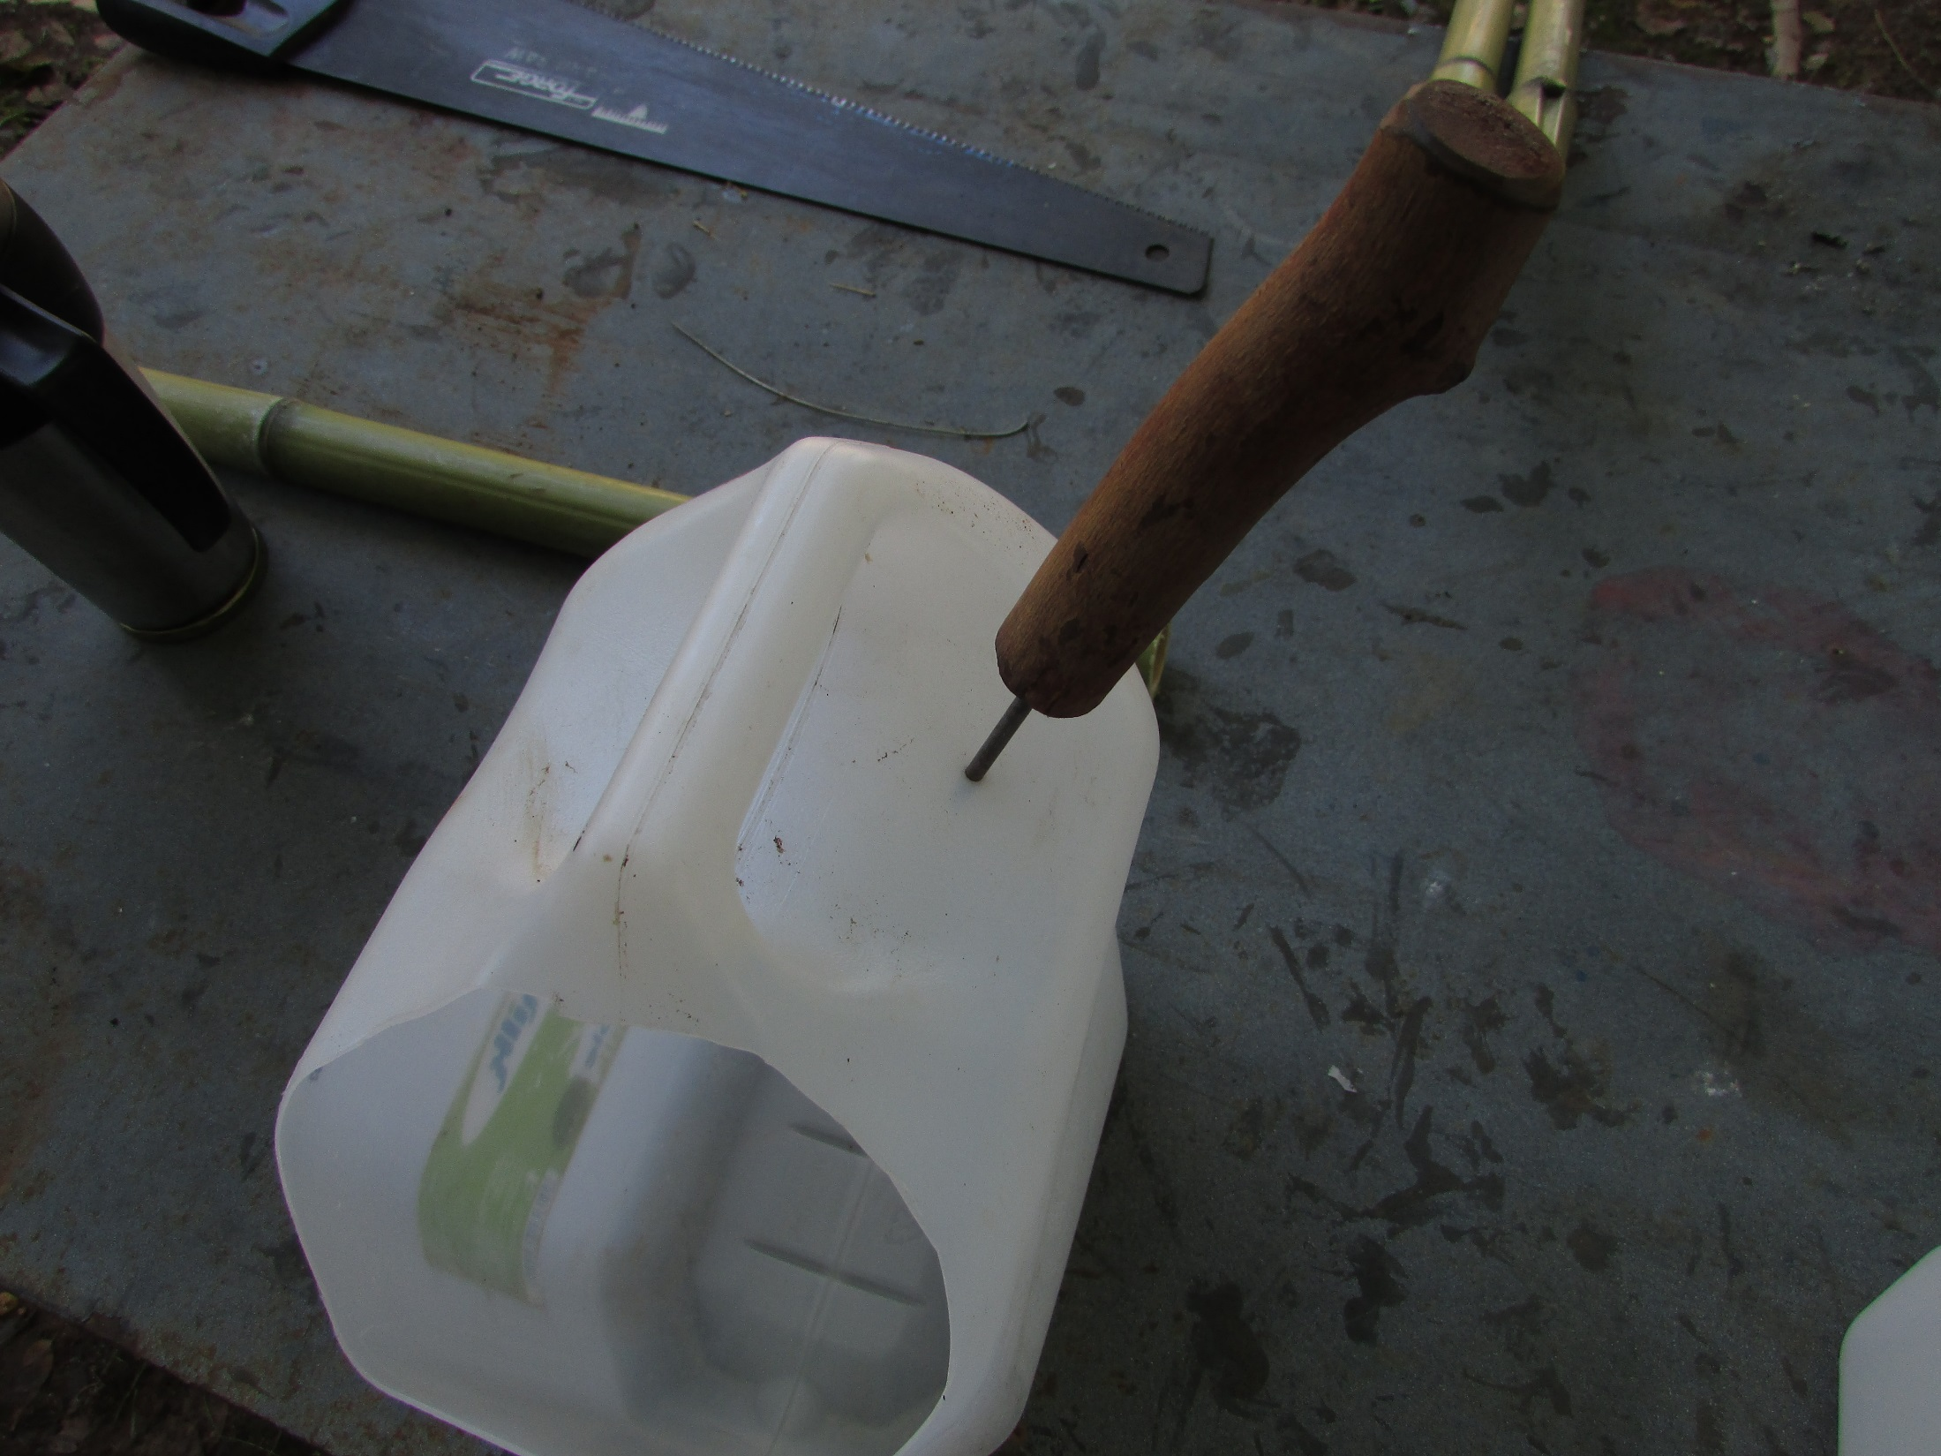
Punch a marker hole
for an irrigation point
(optional)

Slide 21
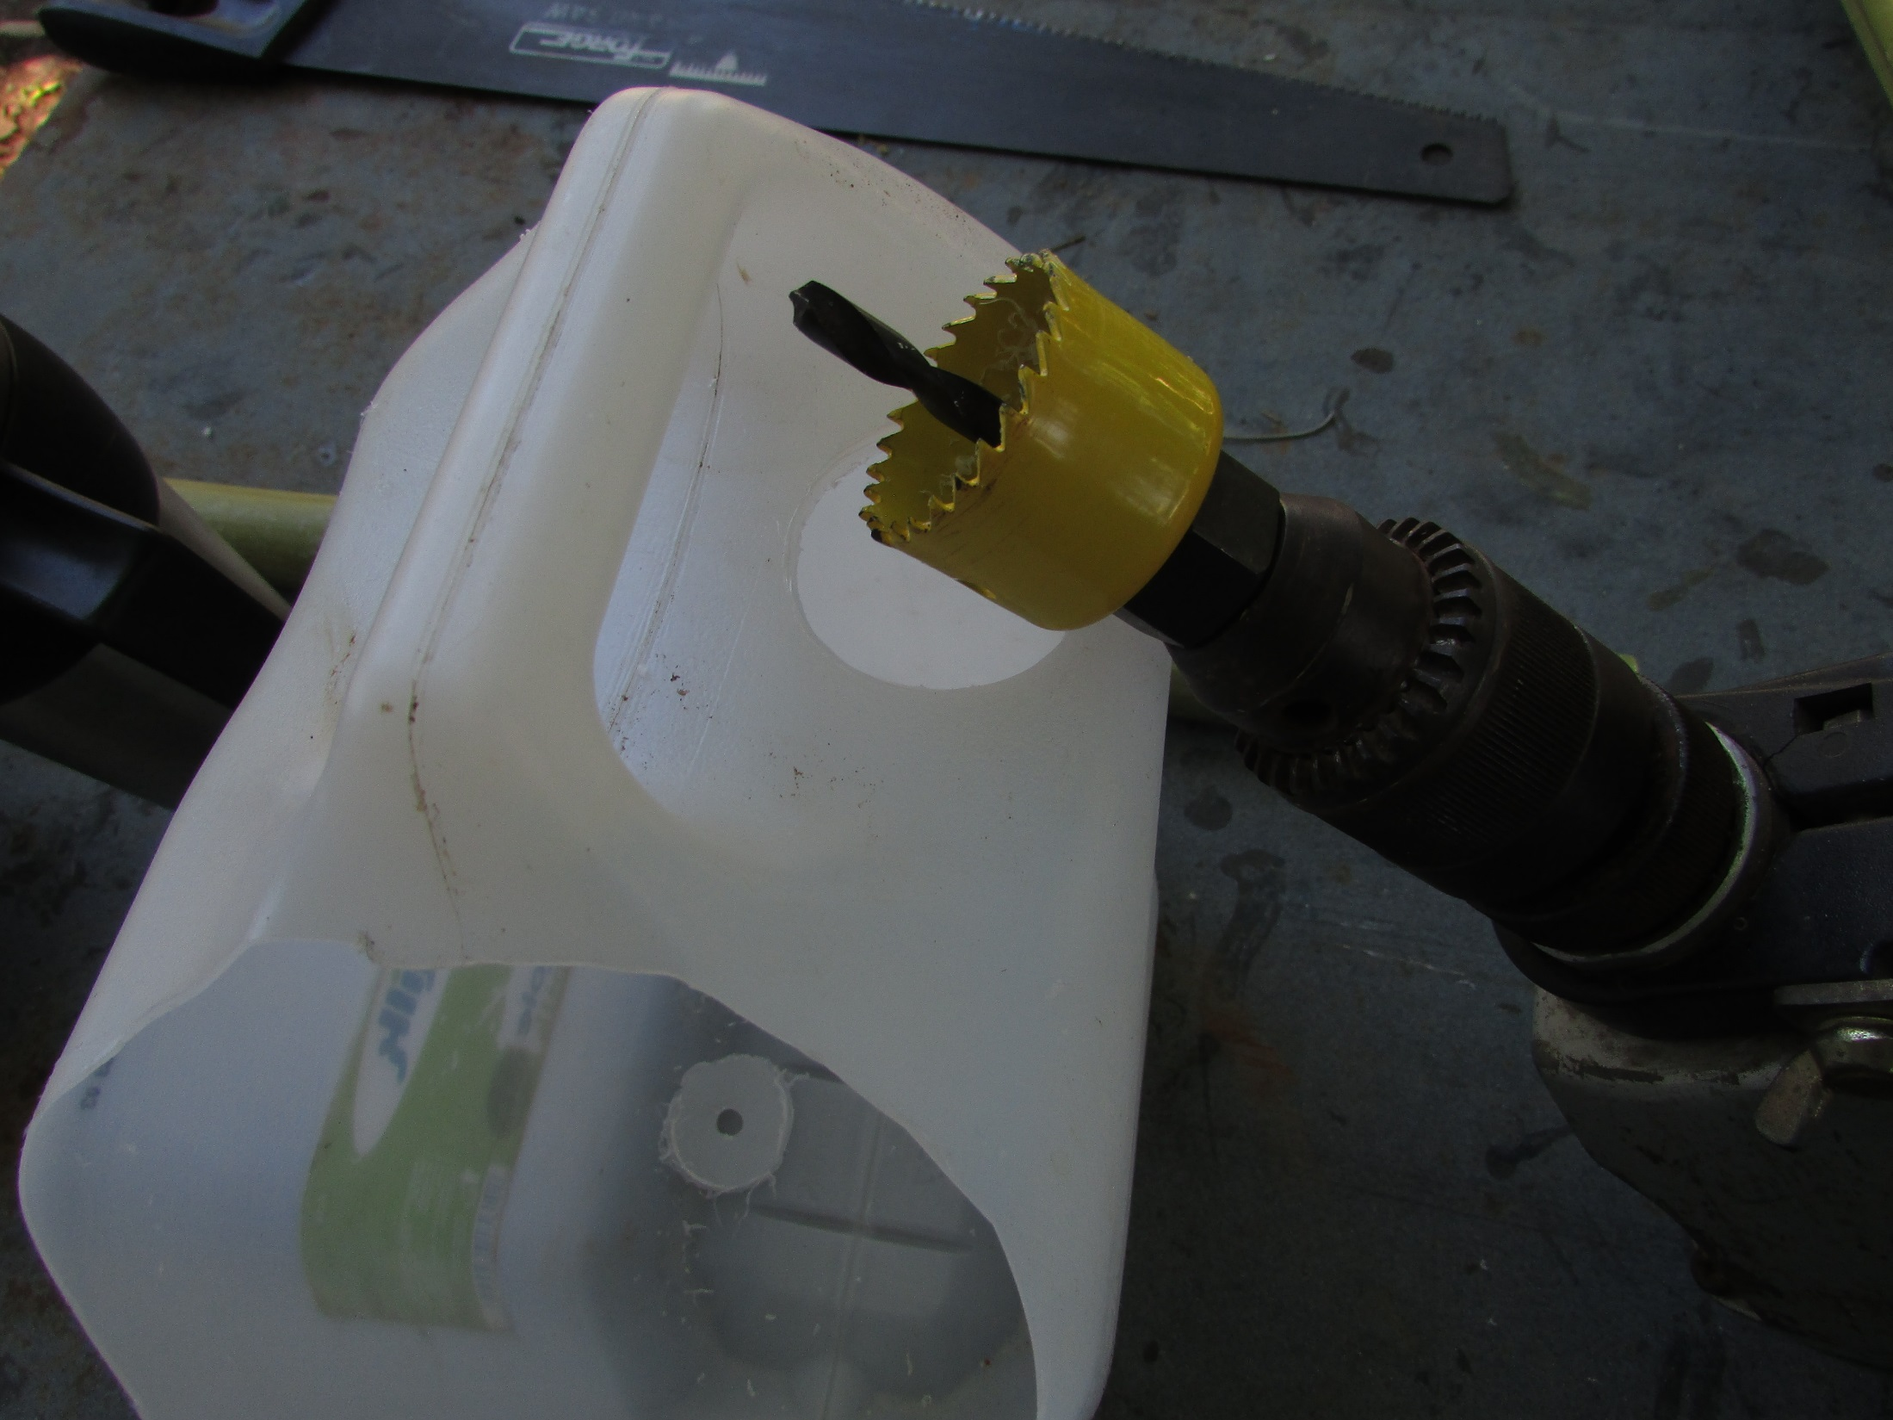

Slide 22
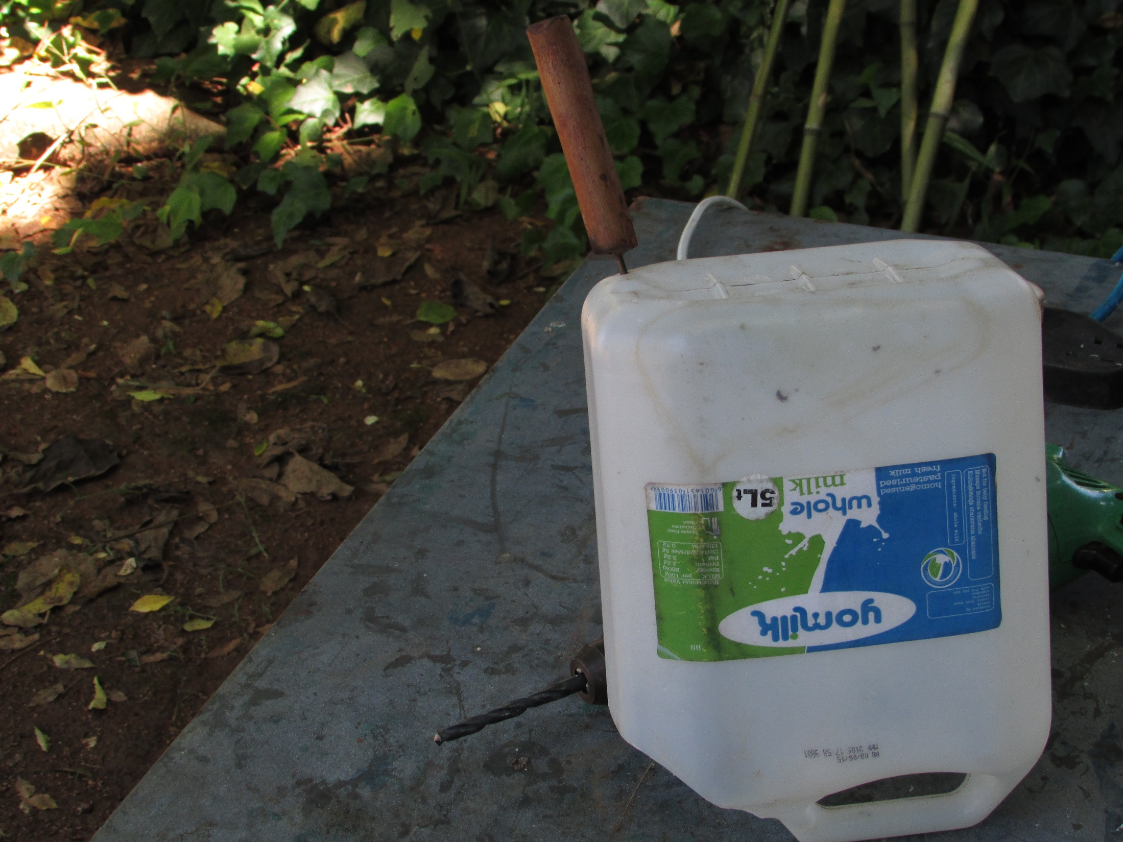
Punch marker holes x 5
at the lowest point

Slide 23
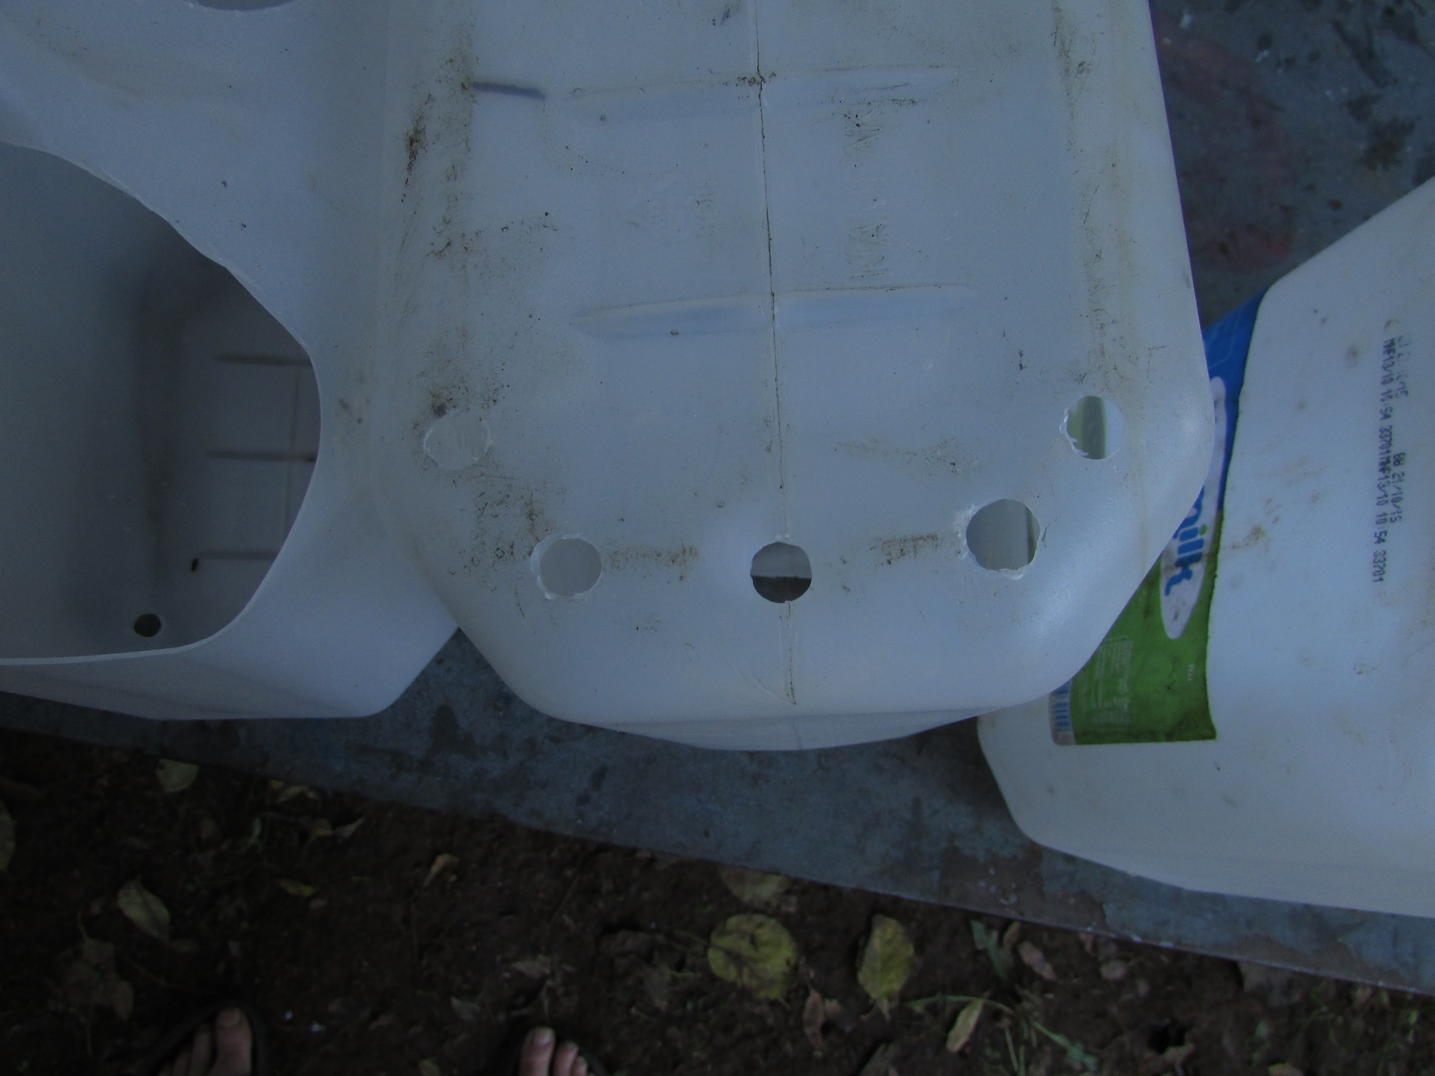
Drill drainage holes
(8mm)

Slide 24
